Slide 1
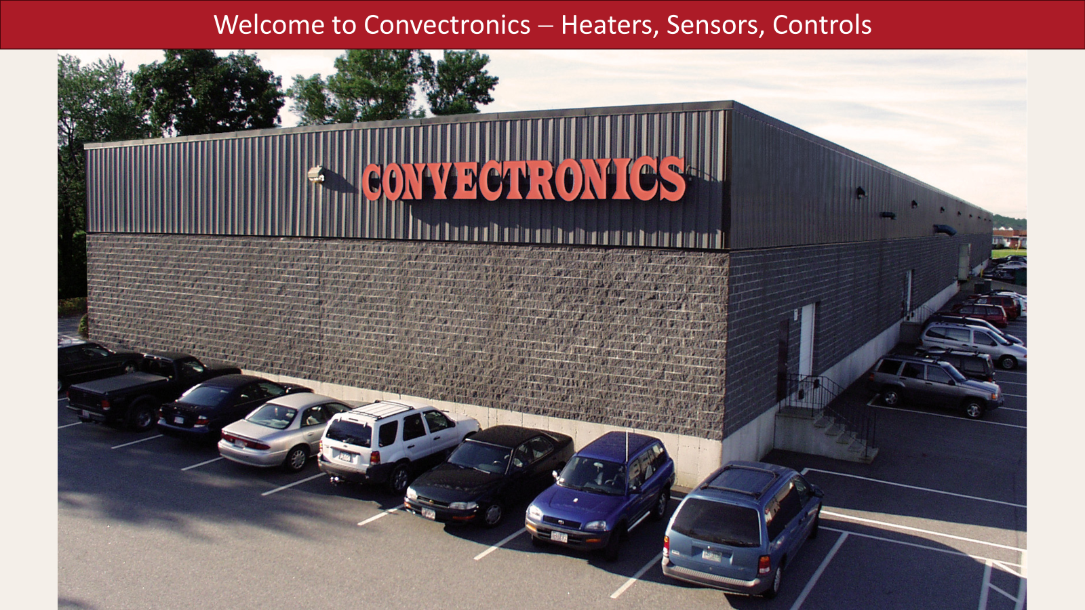

Slide 2
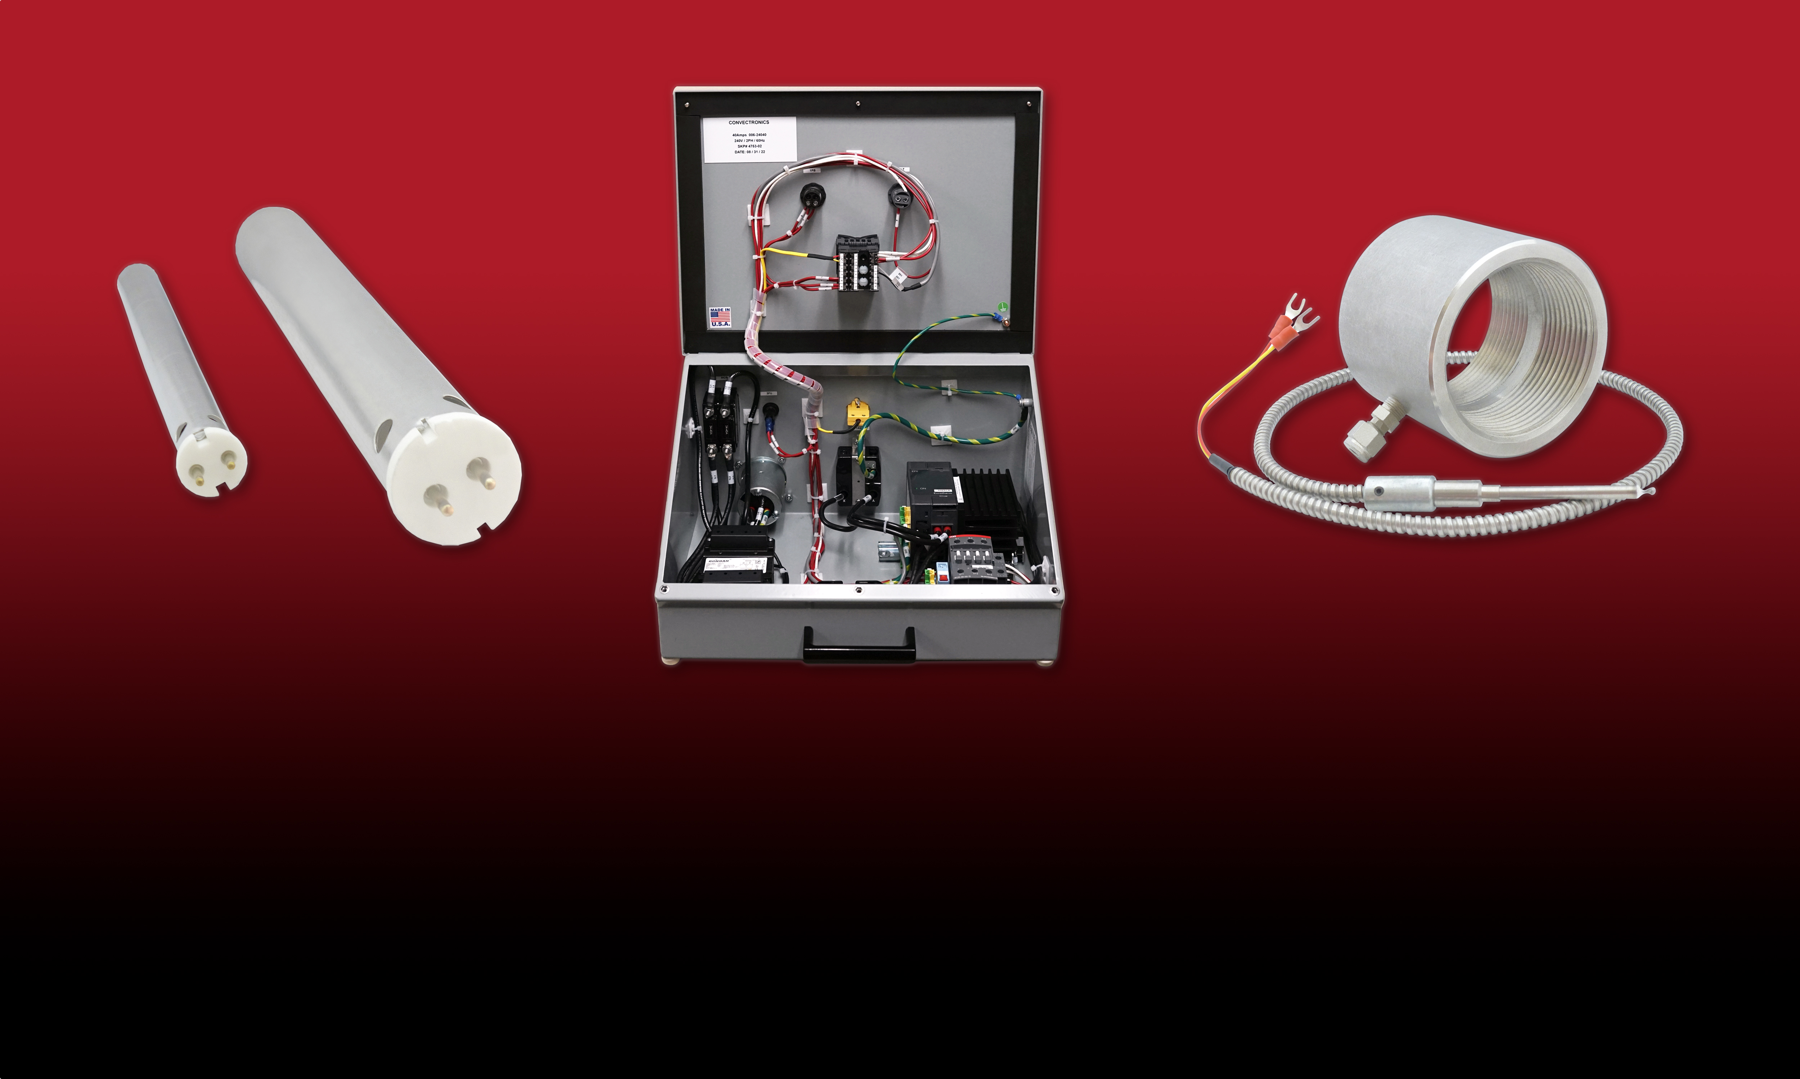
Convectronics has been manufacturing the highest-quality heating elements & sensors since 1985.
We pride ourselves on our dedication to customer service, and quick turn-around on custom orders.
convectronics.com

Slide 3
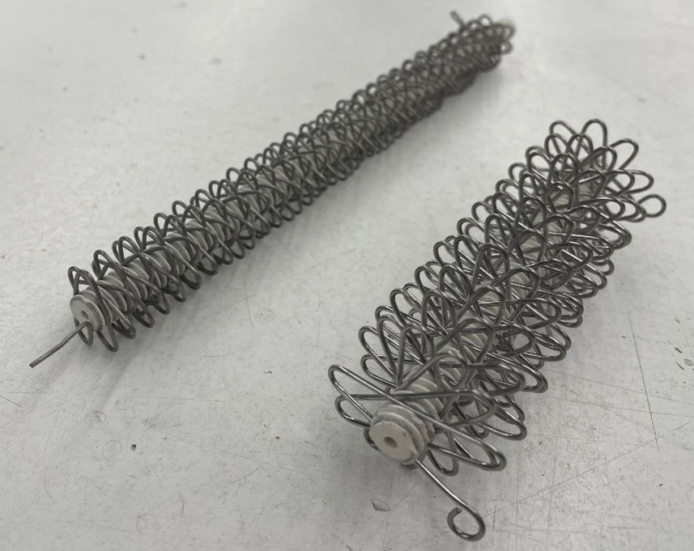
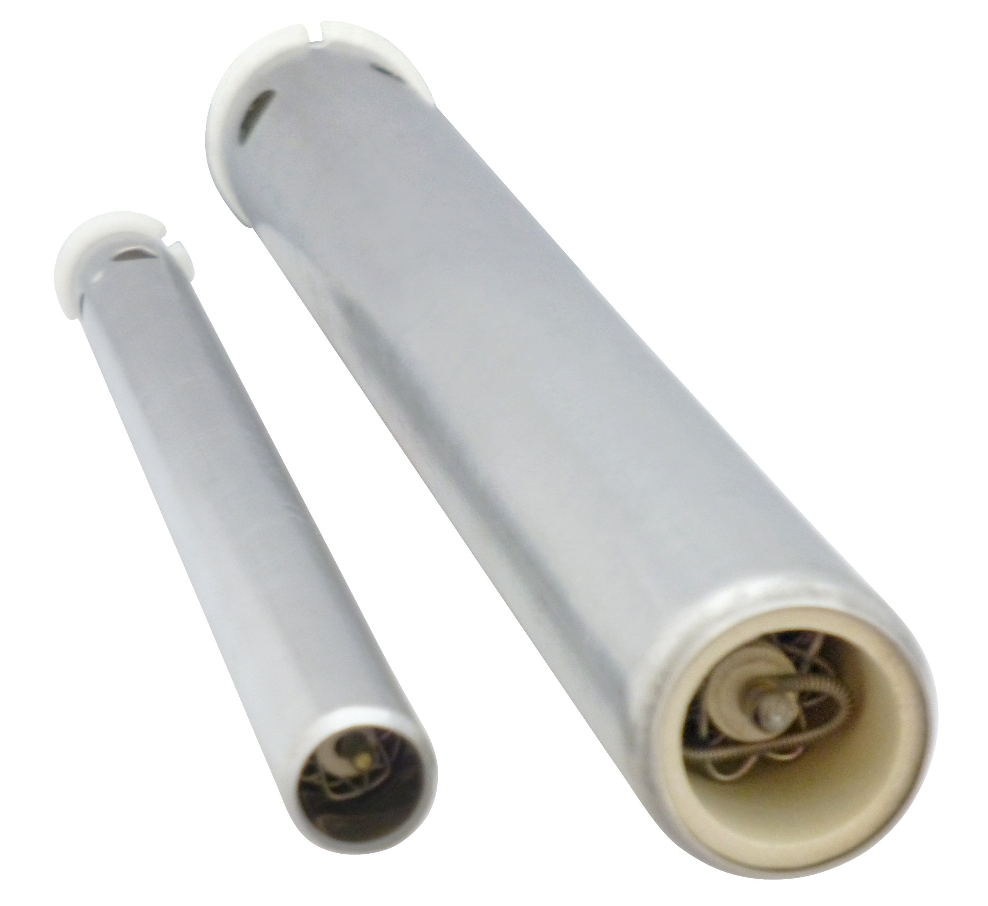
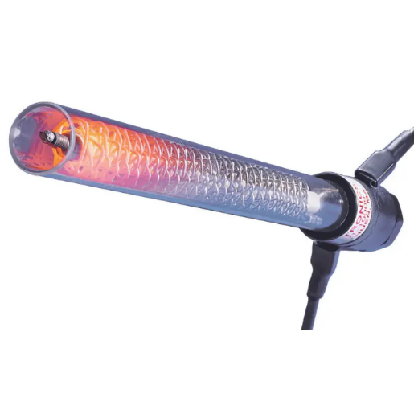
Serpentine Coils
Convectronics is a leading manufacturer of flameless electric air heaters, proudly made in the USA at our Haverhill, Massachusetts facility.
At the core of all our air heaters are our advanced serpentine coils, engineered with cutting-edge alloys specifically designed to endure high temperatures—up to 1300°F—for extended durations.
Our coils deliver superior heat transfer, setting the standard in the industry. This efficient design allows our heaters to operate at lower internal temperatures, resulting in an extended service life.
The coils are threaded onto high-temperature ceramic insulators that provide support and prevent the coil peaks from touching. Any contact between coils can create hot spots and significantly reduce the heater's lifespan.
convectronics.com

Slide 4
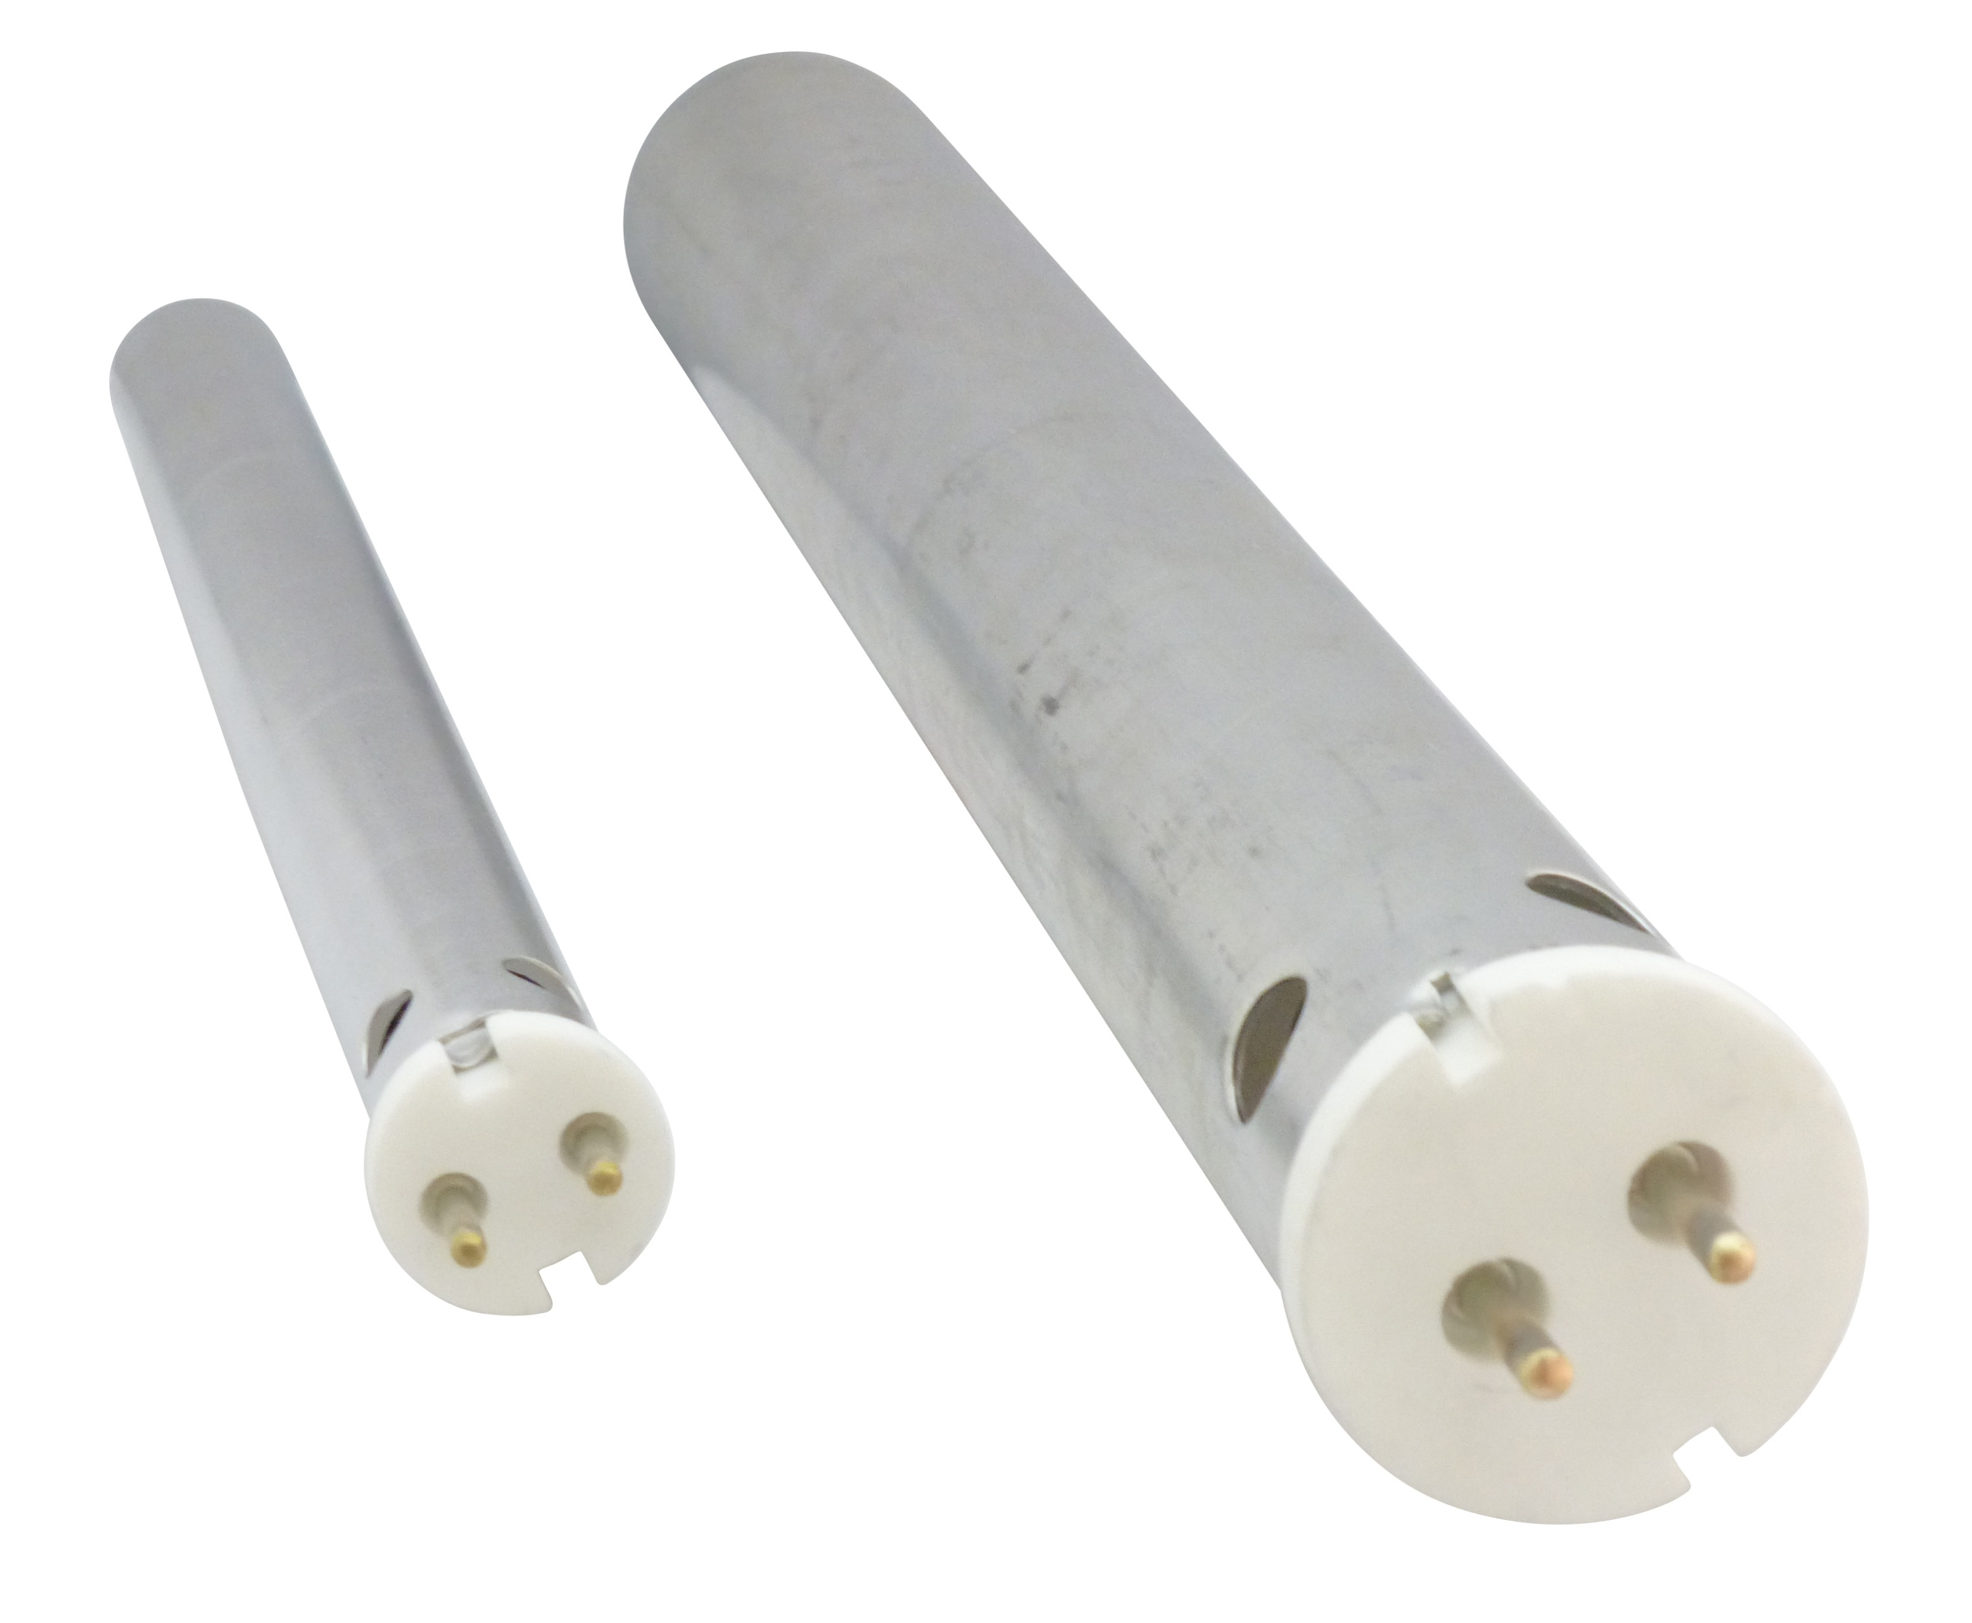
Convectronics vs The Others
Convectronics
Pros:
Direct contact with all key departments—R&D, engineering, quoting, quality, and production.
Flexible and cooperative approach to pricing and sampling.
Willingness to design and manufacture custom heaters.
Short lead times on most products.
Customer service exceeds industry standards.
Convectronics Serpentine Coil Heater Competition:
Tutco Sureheat (Formerly Osram Sylvania GTE)
6kW Tutco P/N: F040292 Convectronics Equivalent: 003-10032
3.6kW Tutco P/N: F029767 Convectronics Equivalent: 003-10030
4.6kW Tutco P/N: F017558 Convectronics Equivalent: 001-10009T
convectronics.com

Slide 5

What Does That Mean?
Short lead times on most products.
Customer service exceeds industry standards
Willingness to design and manufacture custom heaters.
Direct contact with all key departments—R&D, engineering, quoting, quality, and production.
Flexible and cooperative approach to pricing and sampling.
convectronics.com

Slide 6
Air Heater Operation & Selection
How Do Air Heaters Work?
Convectronics flameless electric air heaters operate by directing air (or another non-reactive gas) across electrically energized coils. As the air passes over these coils, heat is efficiently transferred from the element to the moving air, producing a controlled stream of hot air from the heater outlet. Continuous airflow is essential—it prevents the heating element from overheating. Most heater failures occur when there is insufficient or no airflow over the coils.
Key Advantages/Selling Points:
Rapid response time
Consistent, repeatable performance
Highly efficient heat transfer
Safe, flameless operation
convectronics.com

Slide 7
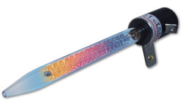
Air Heater Selection
001 Series Heaters
The 001 Series heaters are our smallest and most economical models, designed for low air flow applications. They are available in two outlet configurations: open or nozzle.
Open Exit Heaters
Airflow Range: 50–450 SCFH (0.83–7.5 SCFM)
Wattage Range: 115–4,650 Watts
Nozzle Exit Heaters
Airflow Range: 25–150 SCFH (0.42–2.5 SCFM)
Wattage Range: 115–1,150 Watts
Typical Applications
Product package sealing
Flash removal of plastic
Soldering
Drying and glue curing
convectronics.com

Slide 8
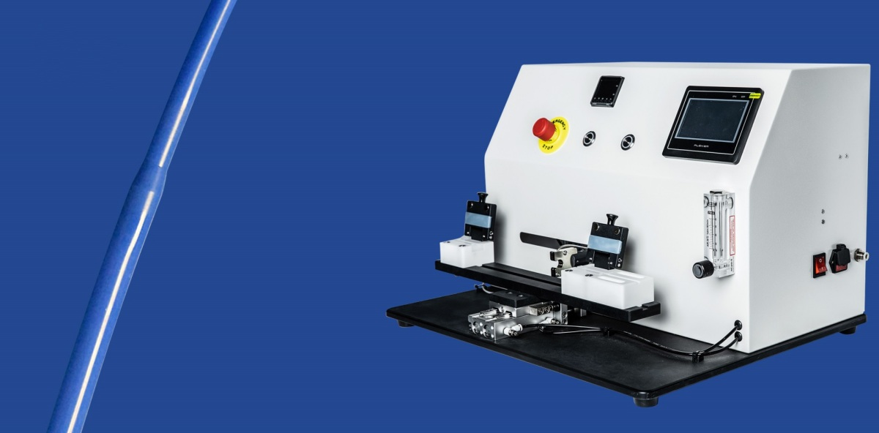
Air Heater Selection
Catheter Laminating Machine
Shown here is a 20 x 17 x 15-inch catheter laminating machine, a compact, tabletop system designed for precision and efficiency. It incorporates a custom version of our 001-10005T, 465-watt single-pass quartz heater, ensuring consistent and controlled heating performance.
Engineered specifically for medical device manufacturing, this laminator delivers efficient, uniform, and high-quality lamination for a wide range of catheter applications. The system leverages the differing melting points, temperature sensitivities, and thermoplastic properties of polymer materials to bond two or more layers together seamlessly.
By providing even, consistent heating throughout the process, the machine minimizes the risk of air bubbles and delamination, resulting in superior product integrity and enhanced overall quality.
Medical Field Customers:
Abbott Labs
Boston Scientific
convectronics.com

Slide 9

Air Heater Selection
Case Study: Fiber Optic Cable Manufacturing
Strategic Account: Long-term partnership with a top tier, global leader in fiber optics.
Equipment Integration: Client utilizes a 1.15 kW nozzle heater to optimize their proprietary production process.
Early Acquisition: Identified the account during their development phase and secured the business via proactive sample testing.
Commercial Value: Evolved from a simple product evaluation into one of our largest, most consistent repeat accounts.
convectronics.com

Slide 10
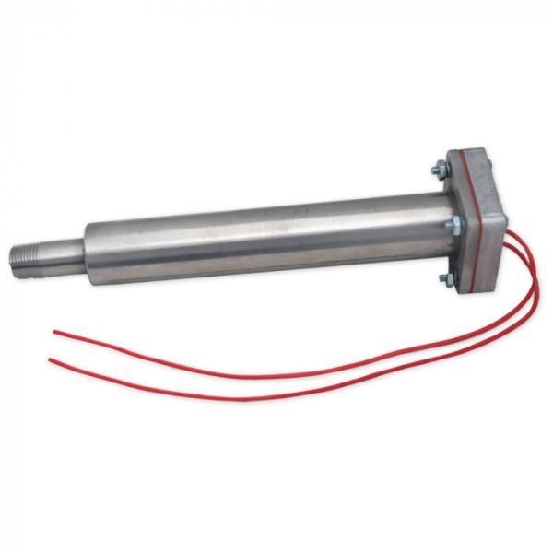
Air Heater Selection
003 Series Heaters – Triple Pass Metal Heaters
The 003 Series is our most efficient and durable heater line—engineered for high-volume production environments where reliability and minimal downtime are critical.
10” Housing / Elements
Airflow Range: 100–1,000 SCFH (1.67–16 SCFM)
Wattage Range: 2,000–4,600 Watts
13” Housing / Elements
Airflow Range: 200–2,000 SCFH (3.3–32 SCFM)
Wattage Range: 5,000–8,000 Watts
Typical Applications
Food industry: plastic keg cups, food containers, coffee cup lids
Flash removal of plastic
Glue curing and fabric welding (e.g., Gore-Tex materials)
convectronics.com

Slide 11
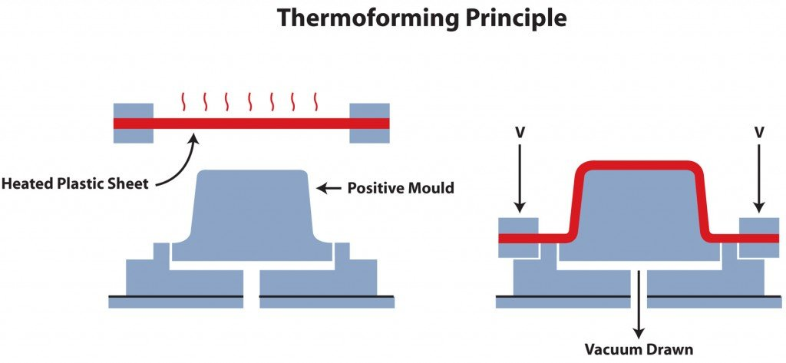
Air Heater Selection
Typical Applications
Food industry: plastic keg cups, food containers, coffee cup lids
Flash removal of plastic
Glue curing and fabric welding (e.g., Gore-Tex materials)
convectronics.com

Slide 12
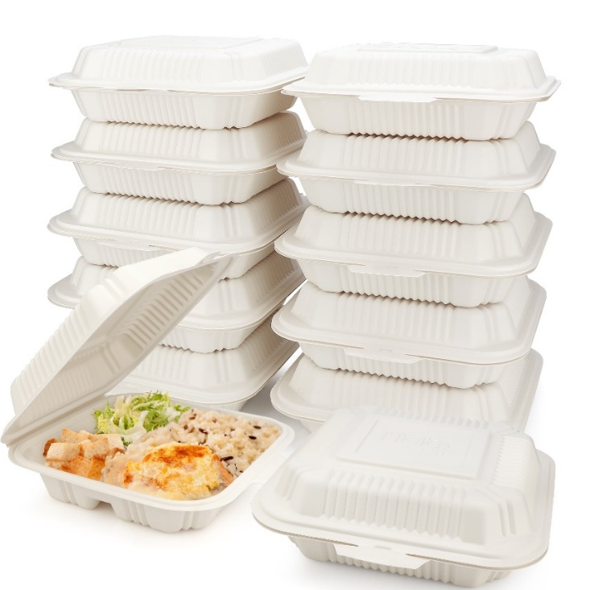
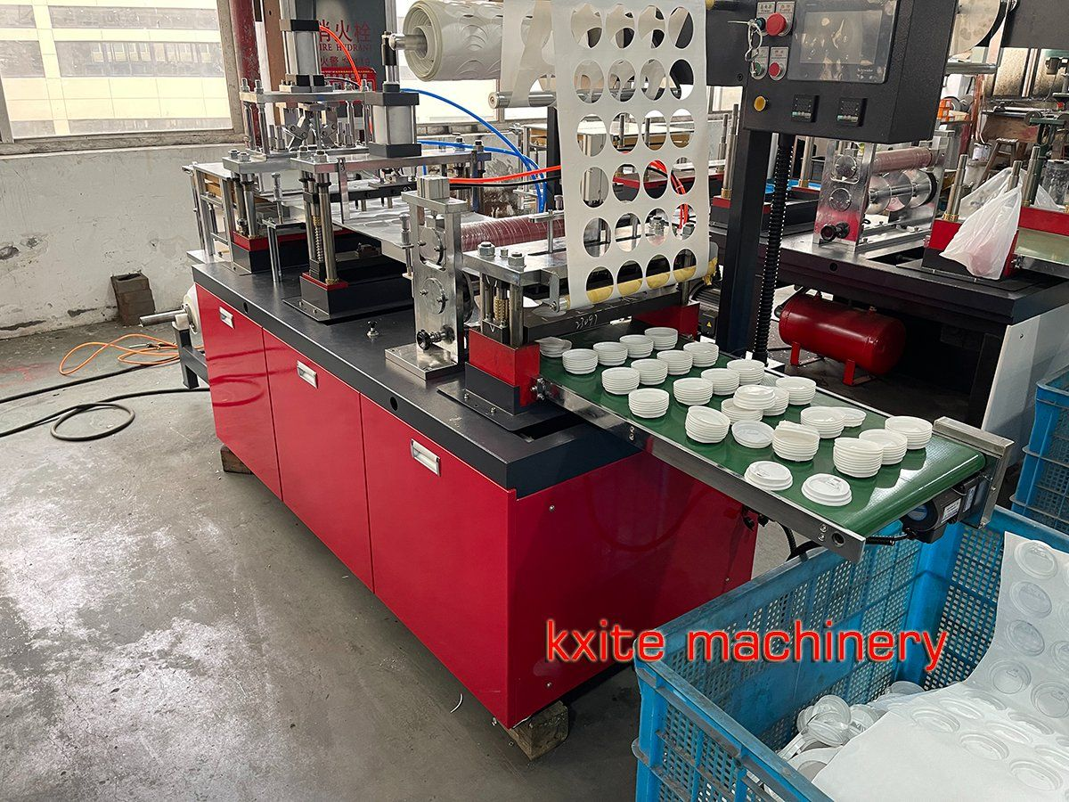

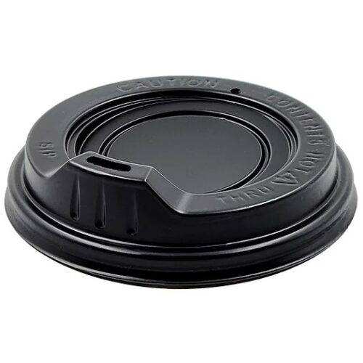
Air Heater Selection
convectronics.com

Slide 13
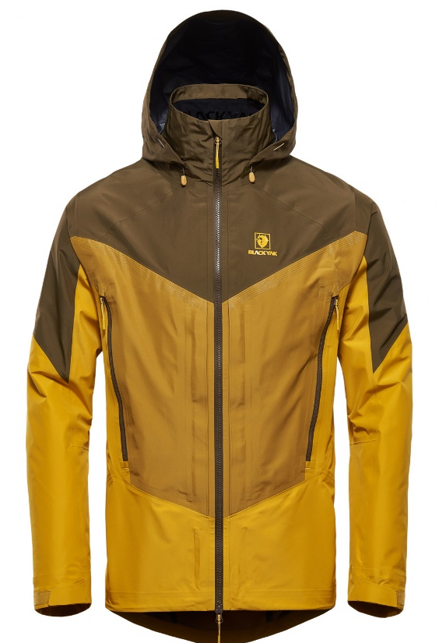
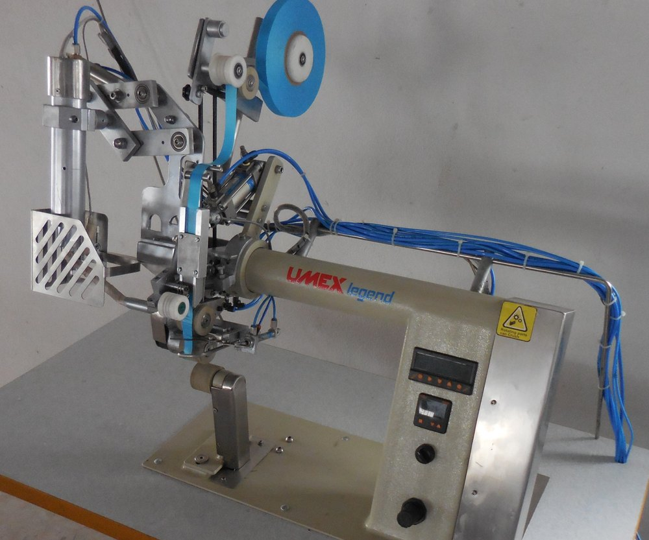
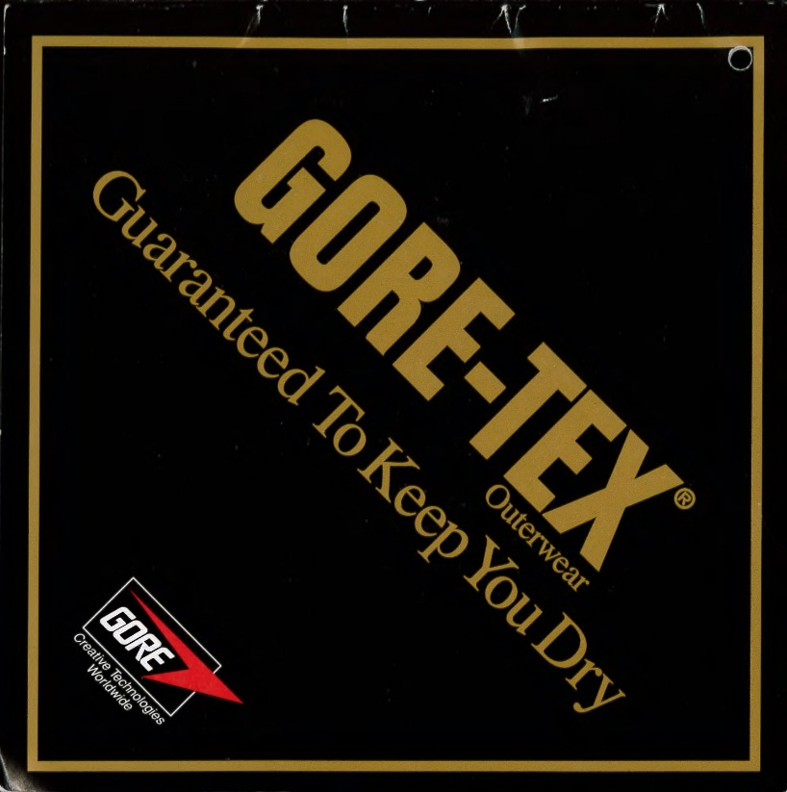
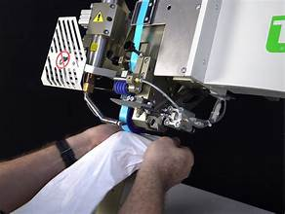
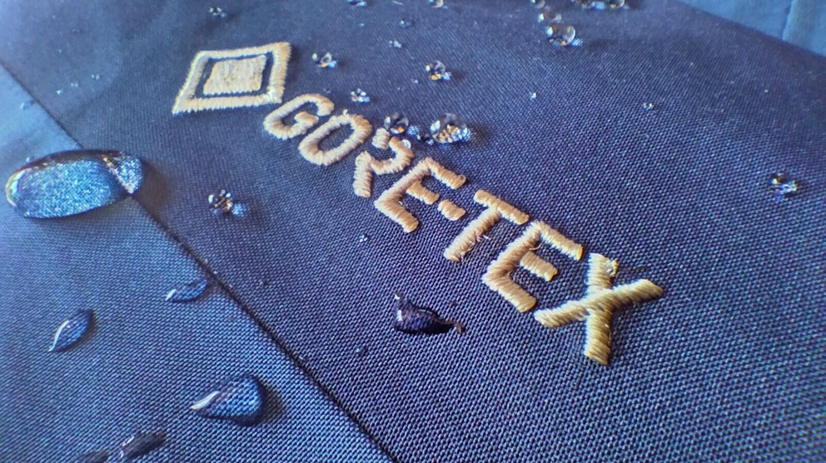
Air Heater Selection
convectronics.com

Slide 14
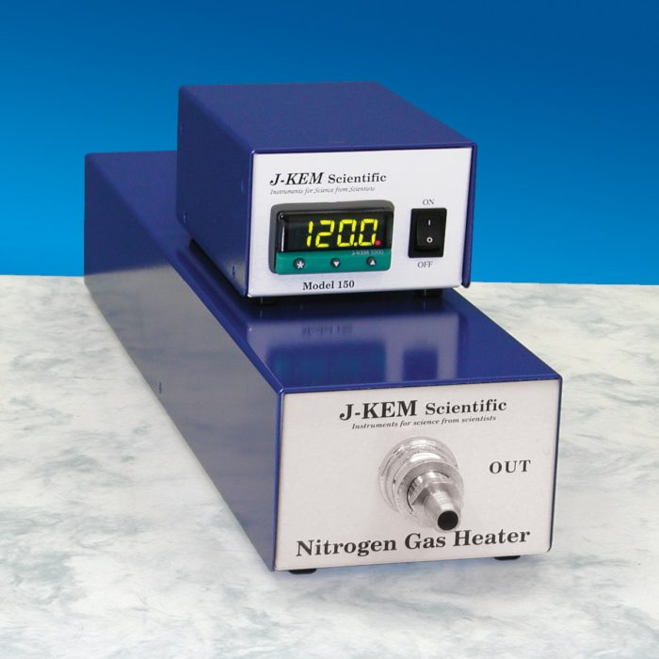
Air Heater Selection
Nitrogen Gas Heater
(Instruments for Science — from Scientists)
The Nitrogen Gas Heater is designed to precisely regulate the temperature of nonflammable gases, providing a safe and reliable heat source for use in safety-critical environments. Its intrinsically safe design makes it ideal for both laboratory and classroom applications.
Specifications:
Dimensions: 19 x 4.5 x 5.5 inches
Weight: 4 lbs
convectronics.com

Slide 15
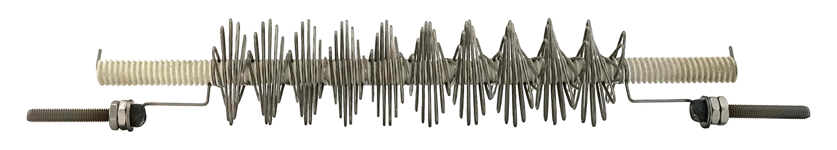
Air Heater Selection
005 Series Air Heaters
The 005 Series air heaters feature a modular design with no back pressure, making them ideal for applications requiring the highest air flow rates. These heaters are designed to operate within a customer-supplied plenum or duct system for maximum flexibility and integration.
Specifications
Wattage Range: 350 – 8,550 Watts
convectronics.com

Slide 16
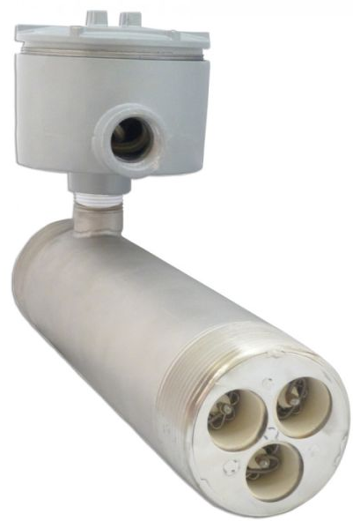
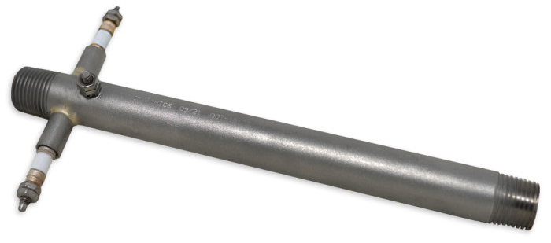
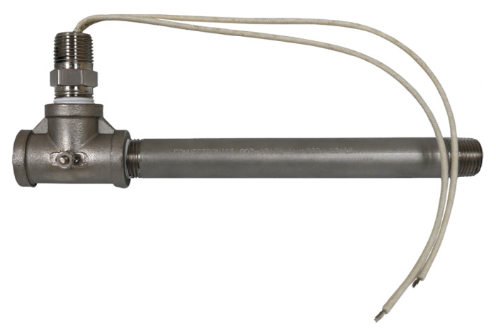
Air Heater Selection
007 Series Air Heaters
The 007 Series Air Heaters are engineered for use in closed-loop, pressurized systems where precise temperature control and reliability are critical. Available in both low-pressure (20 psi) and high-pressure (150 psi) versions, these heaters are ideal for a wide range of industrial and research applications.
Standard Models
Airflow Range: 50–2,000 SCFH (0.83–33 SCFM)
Wattage Range: 800–6,000 Watts
Pressure Options: 20 psi (low) or 150 psi (high)
Typical Applications
Commonly used in universities and testing laboratories for experimentation, research, and product testing.
007 High-Volume Inline Pipe Heater
The High-Volume Inline Pipe Heater is the largest model in the 007 Series, built for applications requiring high power and airflow. Designed for 240V, 3-phase operation, this robust heater delivers exceptional performance in demanding process heating environments.
Specifications
Voltage: 240V, 3-phase
Power: 18 kW
Maximum Airflow: 60 SCFM
Pressure Rating: 20 psi
convectronics.com

Slide 17
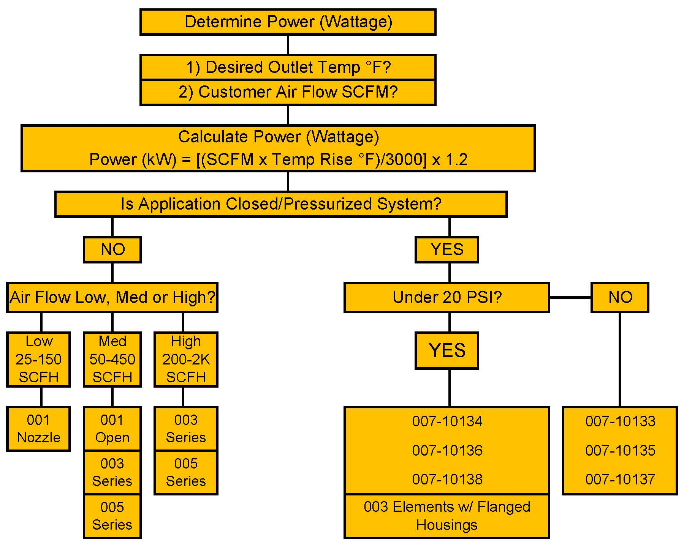
Air Heater Selection
convectronics.com

Slide 18
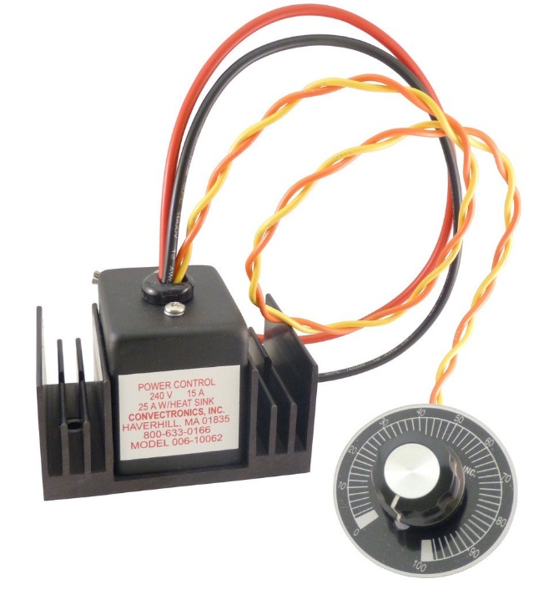
Controlling Air Heaters
Controlling Air Heaters
Air heaters can be controlled in two ways: open loop and closed loop configurations.
Open Loop Control
Open loop control provides a manual method of adjusting voltage to the heater. It is simple, cost-effective, and ideal for applications where temperature precision is not critical.
Shown is the 006-10062 Power Module, which is commonly used for open loop control.
Key Characteristics:
No feedback or automatic adjustment if air flow stops
Suitable for applications where output temperature precision is less critical
Works well for lower output temperature requirements
Most economical way to control an air heater
Caution: Can cause heater damage if air flow stops, as there is no feedback protection
convectronics.com

Slide 19
Controlling Air Heaters
Closed Loop Control
Closed loop configurations provide precise temperature control by using feedback from a temperature sensor to automatically regulate heater power. This setup continuously adjusts output to maintain a stable outlet temperature, even if air flow or ambient conditions change.
A typical closed loop system consists of three components:
Power Controller – either a phase-angle fired SCR or zero-cross solid-state relay (SSR)
Temperature Controller – sets and maintains the desired temperature
Sensing Thermocouple – placed at the outlet of the heater to provide feedback
Key Advantages:
Maintains accurate and stable output temperatures
Automatically compensates for variations in air flow or load
Protects heaters from overheating and extends lifespan
Ideal for high-precision or temperature-critical processes
convectronics.com

Slide 20
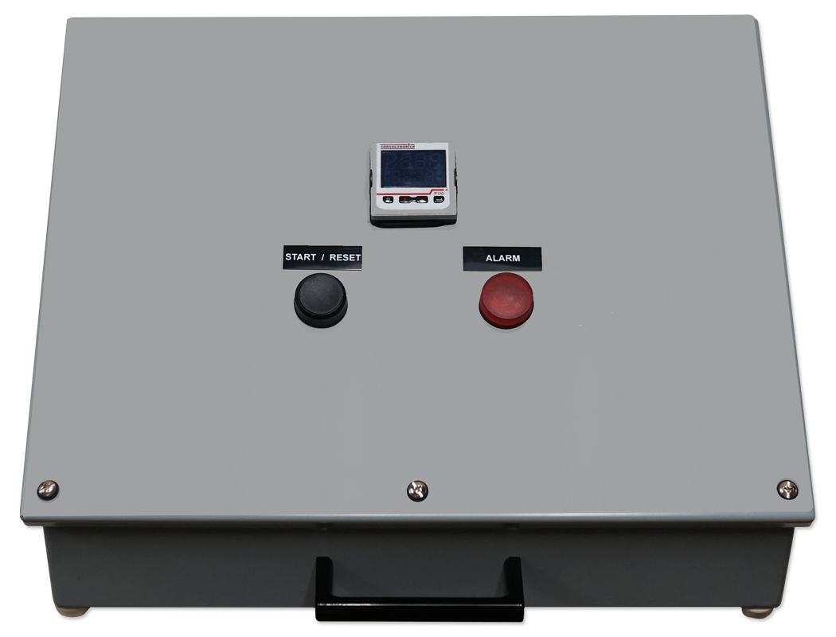
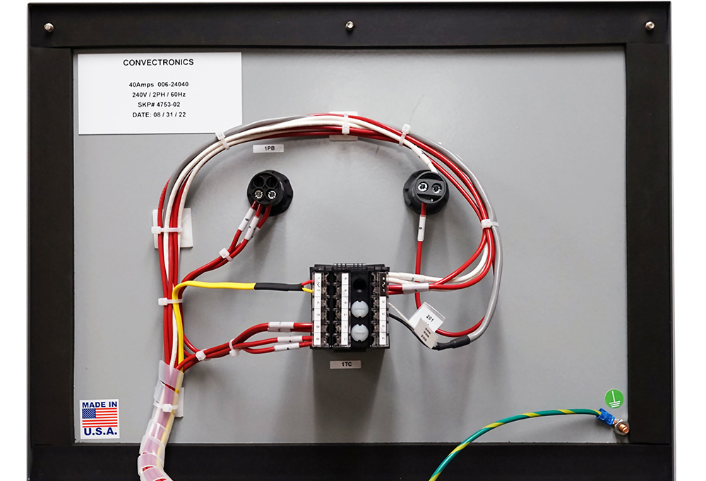
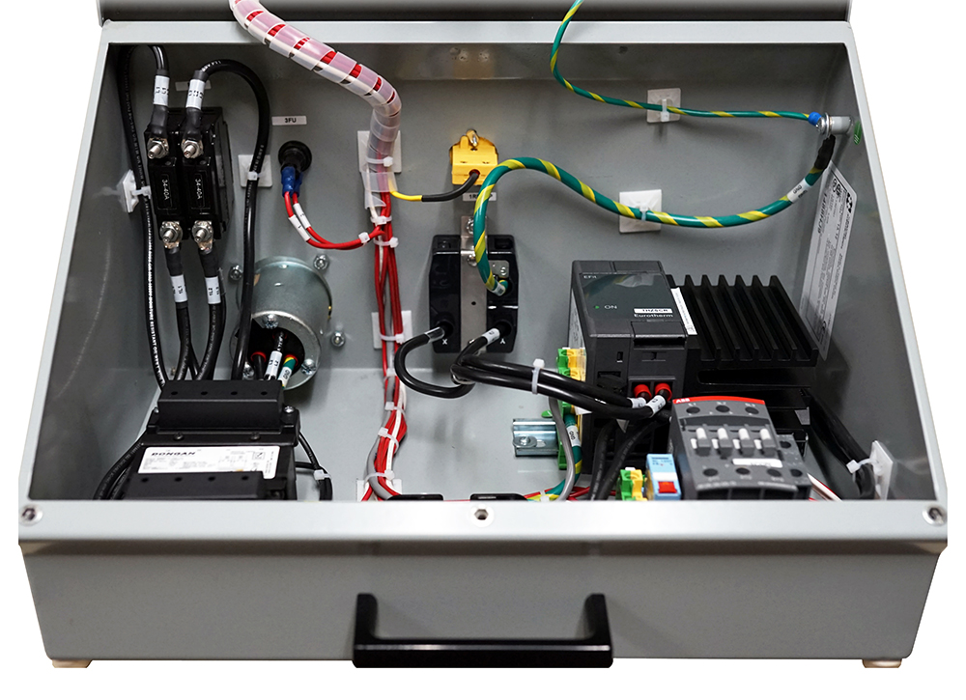
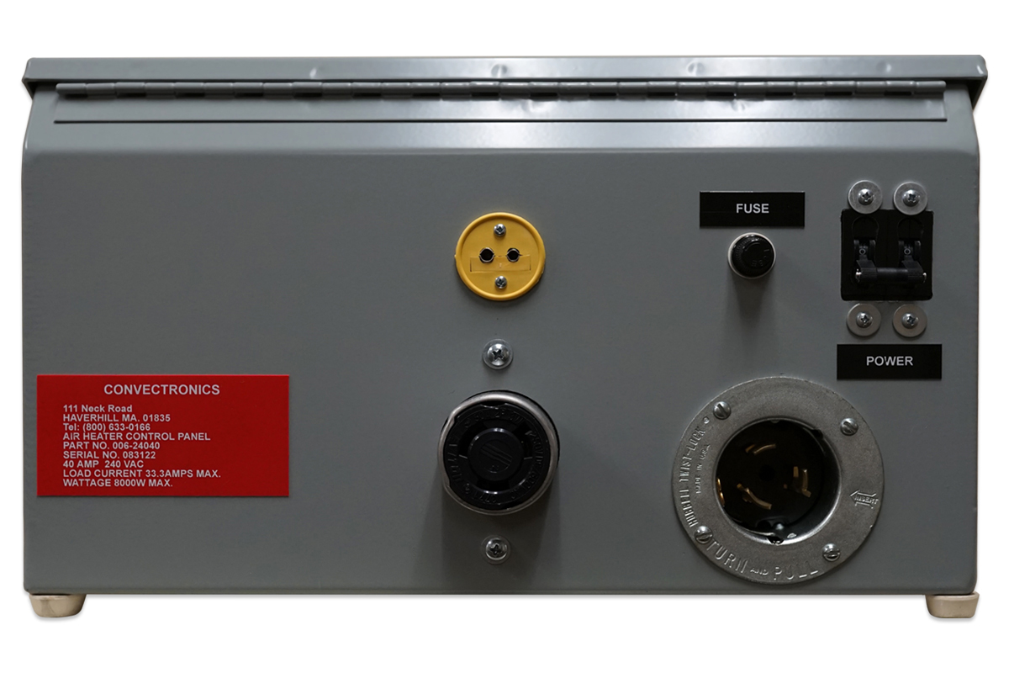
Controlling Air Heaters
Integrated Control Solutions
Convectronics offers both individual control components and fully integrated systems.
For maximum convenience, customers can choose an all-in-one control console, which includes:
A phase-angle fired SCR power controller
A temperature controller
All necessary wiring and connectors housed in a portable, durable enclosure
This integrated control console provides a plug-and-play solution, ideal for laboratory, testing, or production environments where reliability and ease of use are critical.
The Phase Angle Control Consoles are offered in 3 constructions:
006-12015 – 120V 15A
006-24020 – 240V 20A
006-24040 – 240V 40A
convectronics.com

Slide 21

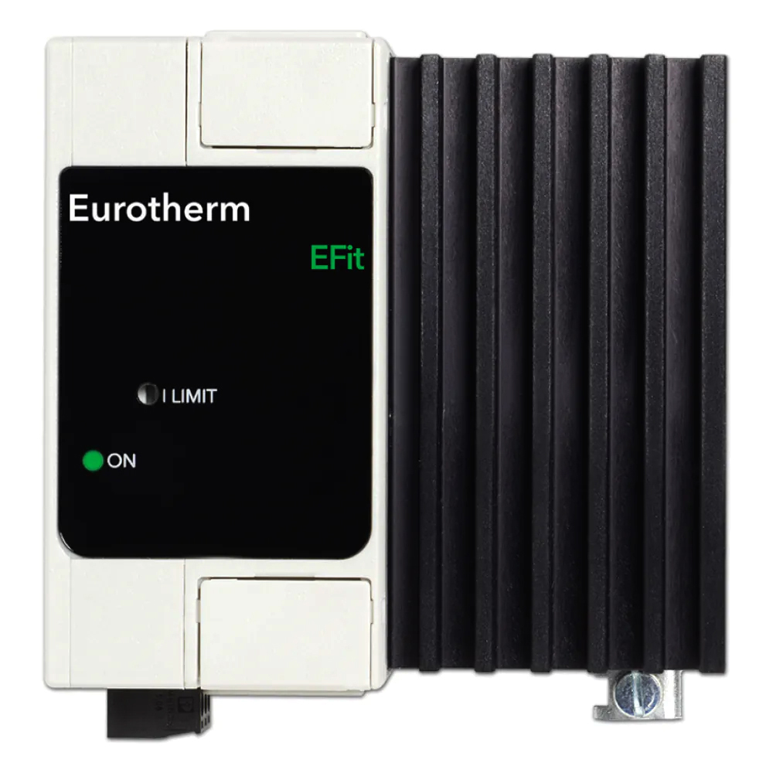
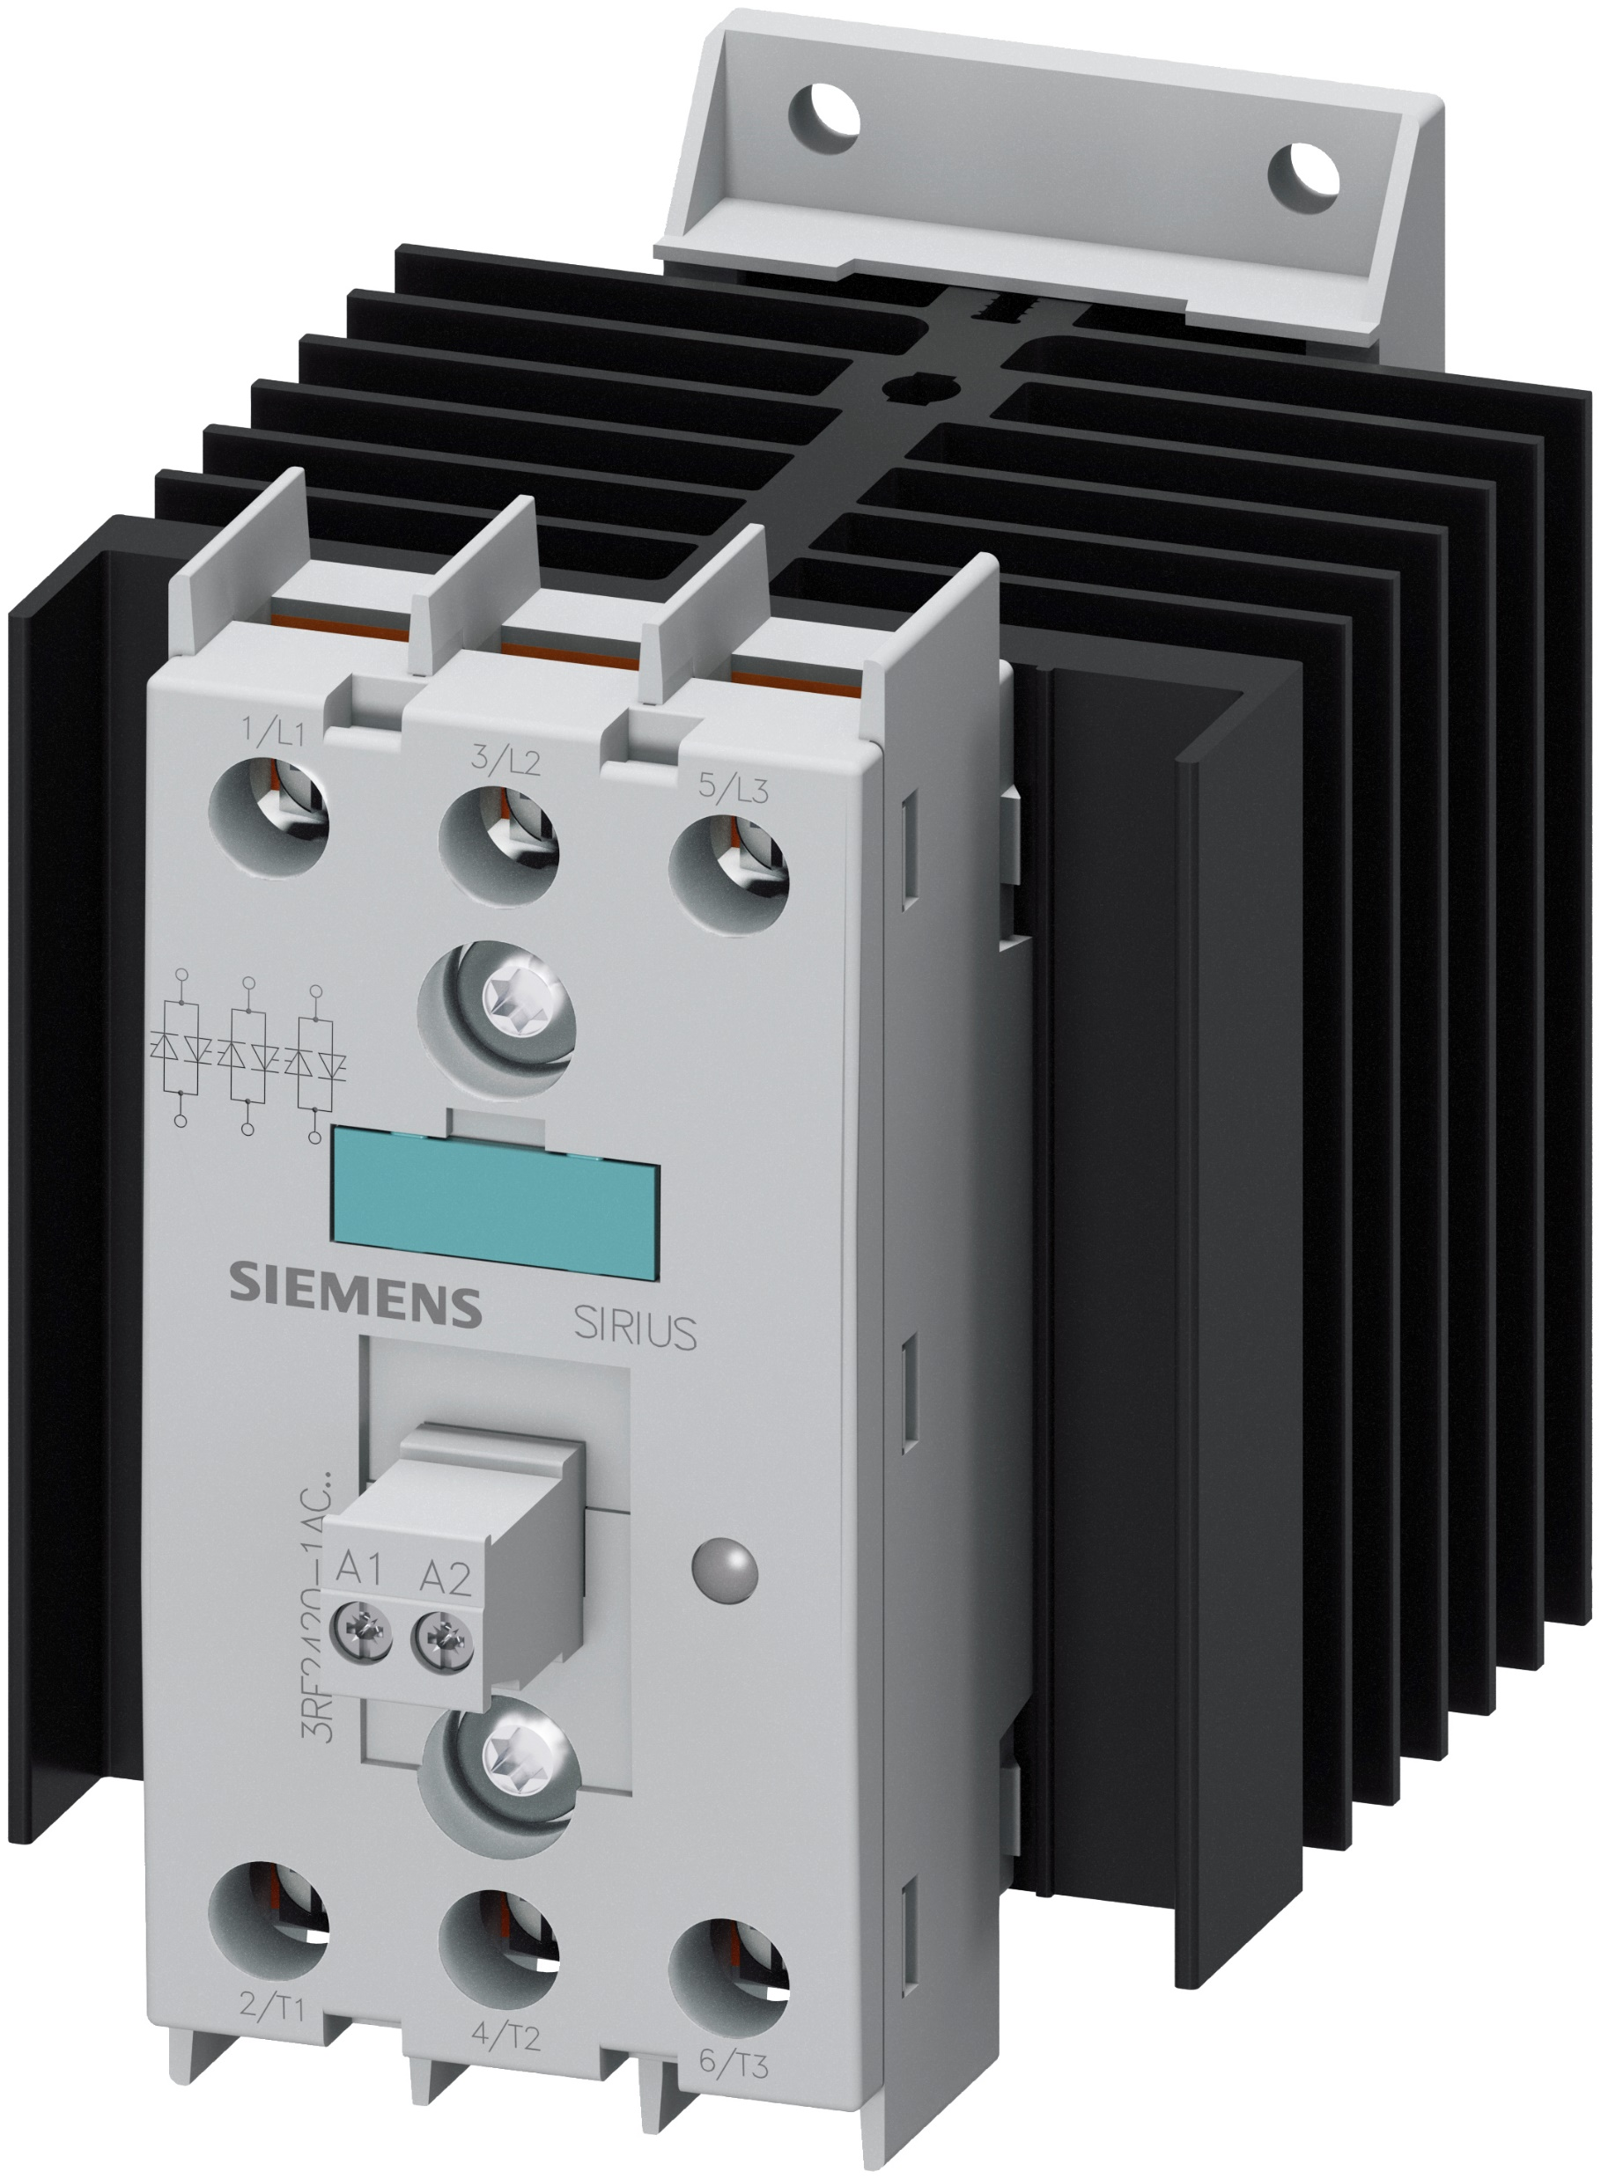
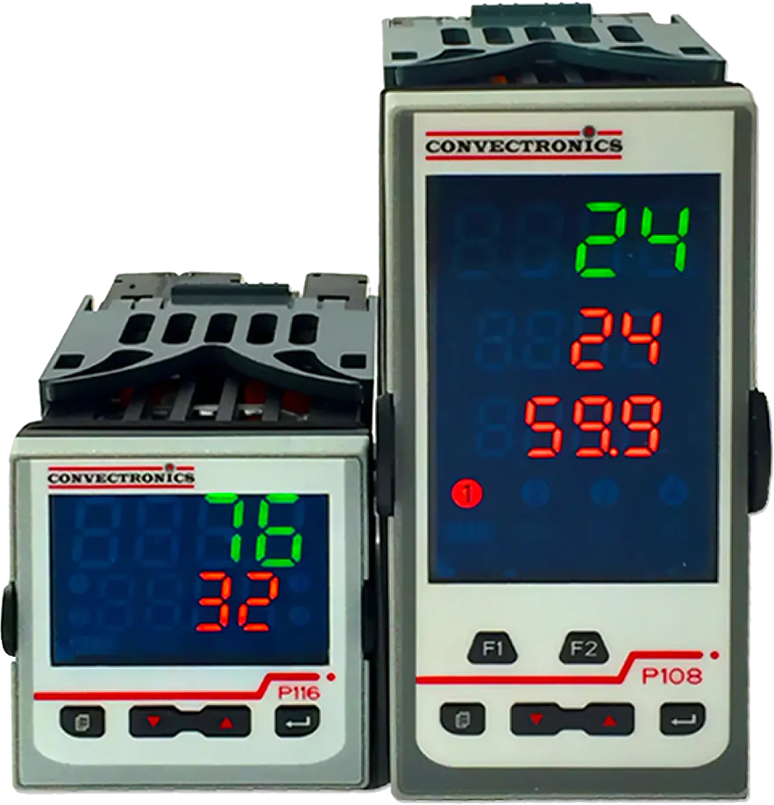
Controls Partners
Piccolo™ Temperature & Process Controllers
Use Cases:
Plastic Processing Control
Incubators
Food and Beverage
Furnaces, Ovens & Kilns
Laboratory Equipment
EFit SCR Power Controller:
The Perfect Fit for Simple Applications
Connect Easily
Improve Processes
Control Precisely
Standardize Globally
SIRIUS Single & Three Phase Solid State Contactors
Suitable for surface mounting on existing cooling surfaces
Version for inductive loads "instantaneous switching“
Special "Low noise" version
convectronics.com

Slide 22
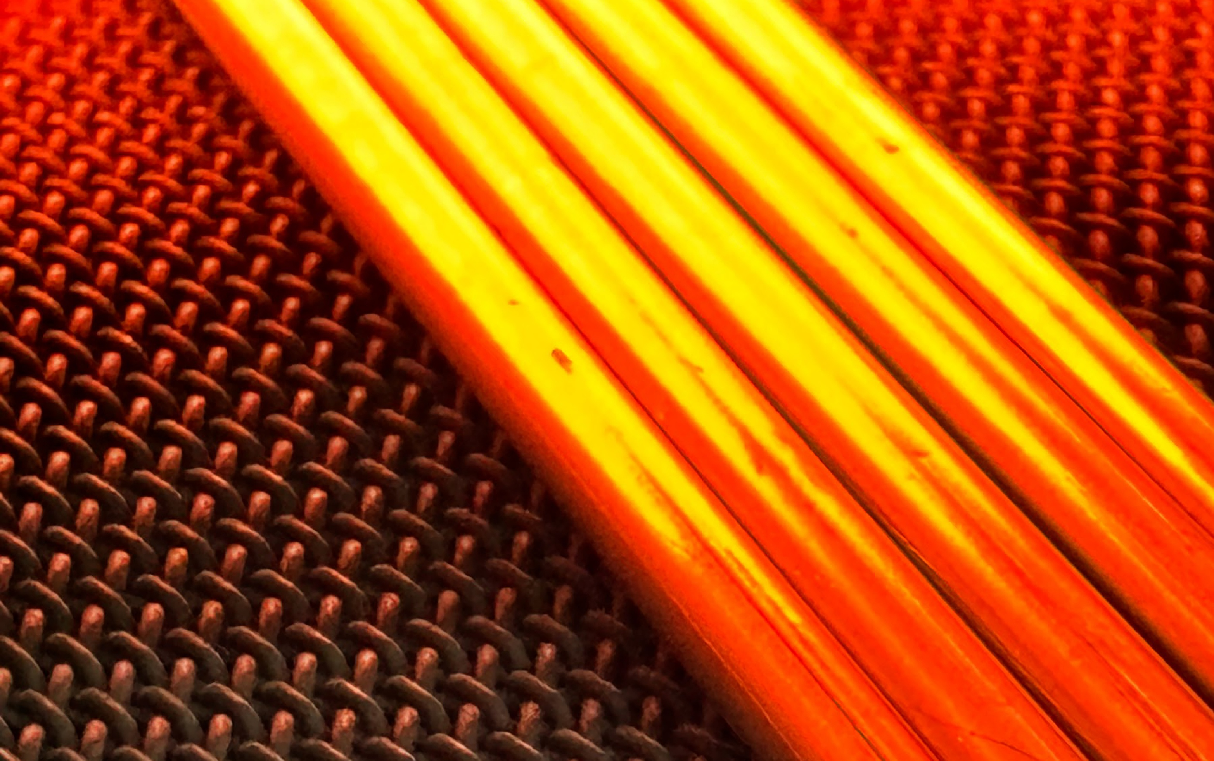
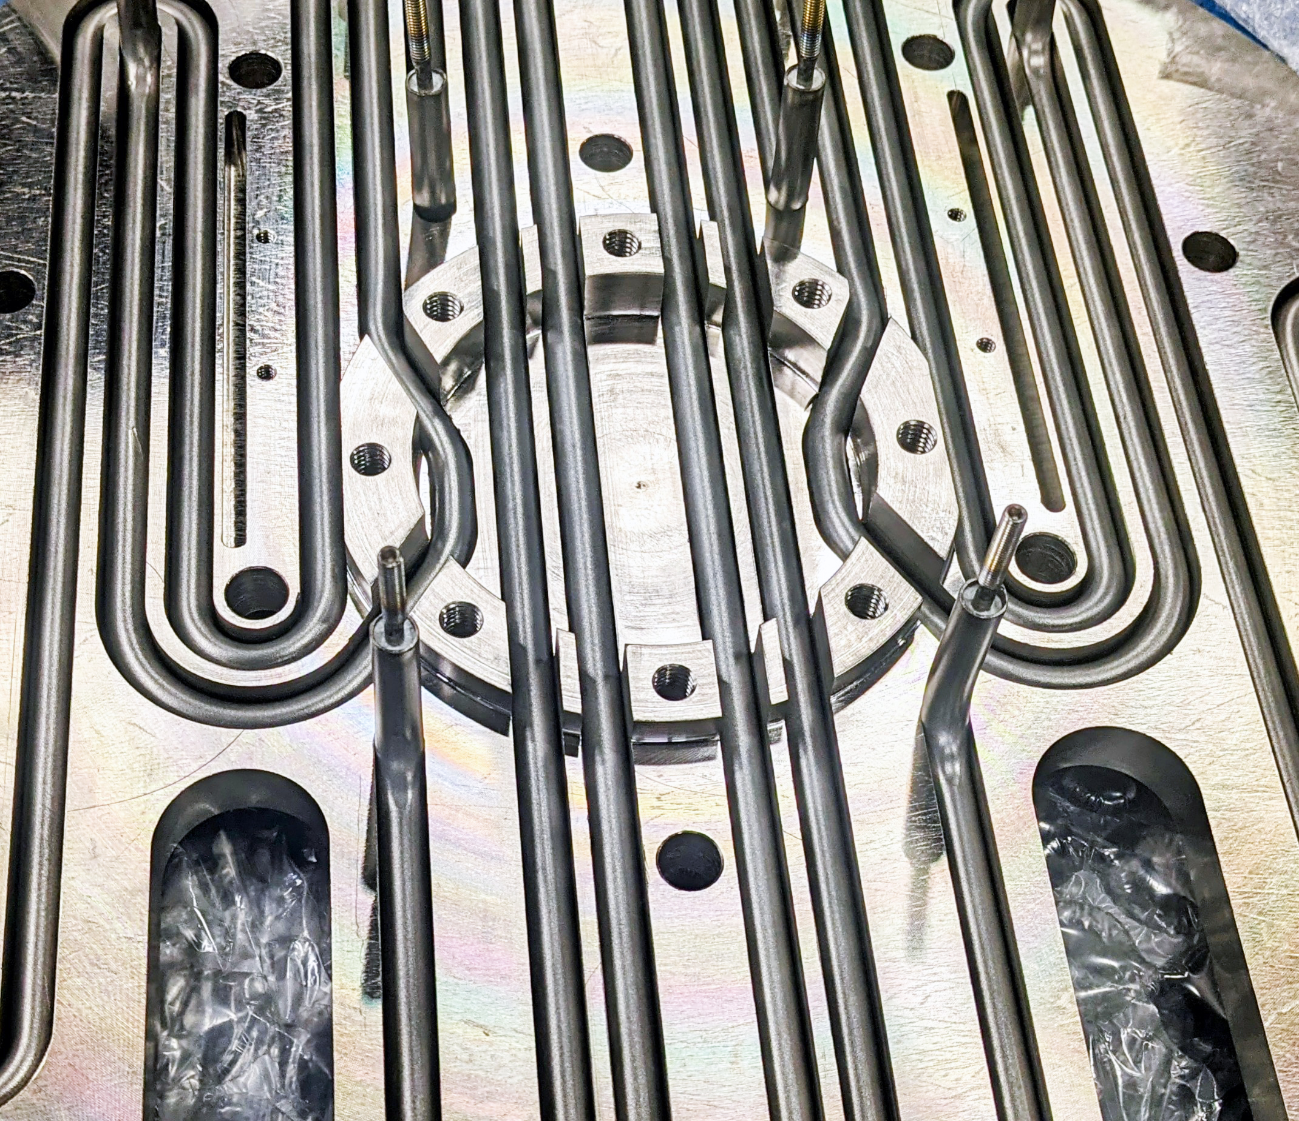
Tubular Electric Heaters
Highly Adaptable Tubular Electric Heaters
Custom Configurations: Fully formable sheath design allows elements to be bent into virtually any shape or layout.
Maximum Versatility: Broad selection of sheath materials, terminations, and power ratings to match unique environments.
Durable Construction: Heavy-duty build quality engineered for long-term reliability.
Cross-Industry Utility: Highly adaptable for complex industrial, scientific, and commercial thermal processing applications.
convectronics.com

Slide 23
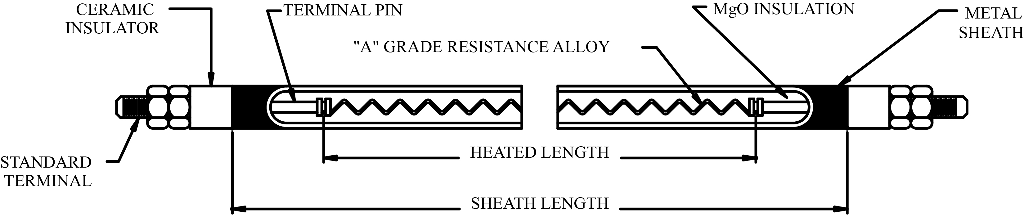
Tubular Electric Heaters
Engineered for Performance
High-Performance Alloys: Available in Incoloy® 800 for superior high-temperature oxidation resistance and T321 Stainless Steel for robust corrosion protection.
Rugged Internal Build: Features a precision-centered nickel-chromium resistance coil packed with compacted magnesium oxide (MgO) for maximum heat transfer.
Compacted Insulation: Vibration-loaded magnesium oxide (MgO) powder guarantees uniform density throughout the element length.
Precision Swaging: Outer diameter reduction compacts the internal insulation, locking the heating coil permanently in the center.
Formable Sheath: Fully annealed finishing enables seamless, crack-free bending either at the factory or directly in the field.
convectronics.com

Slide 24
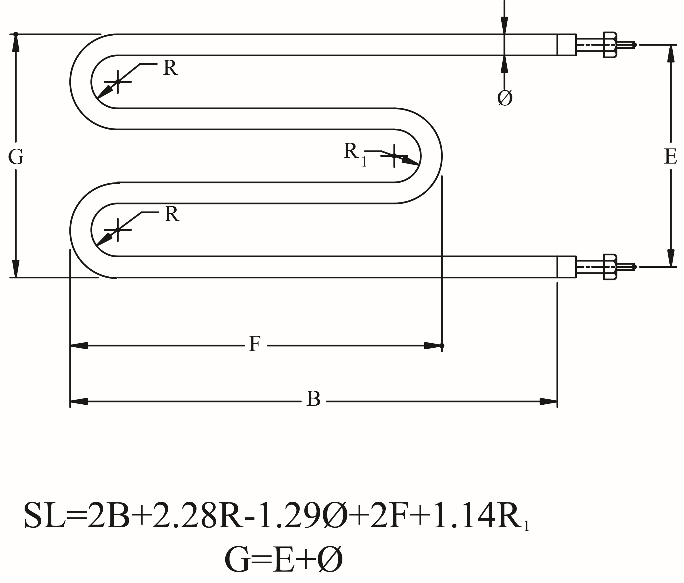
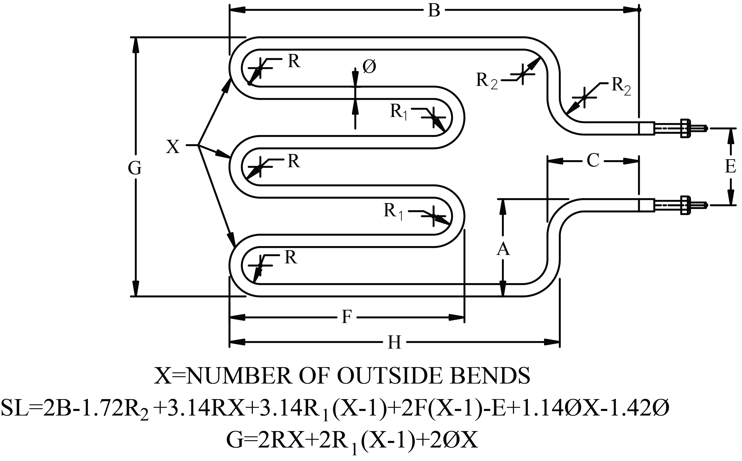
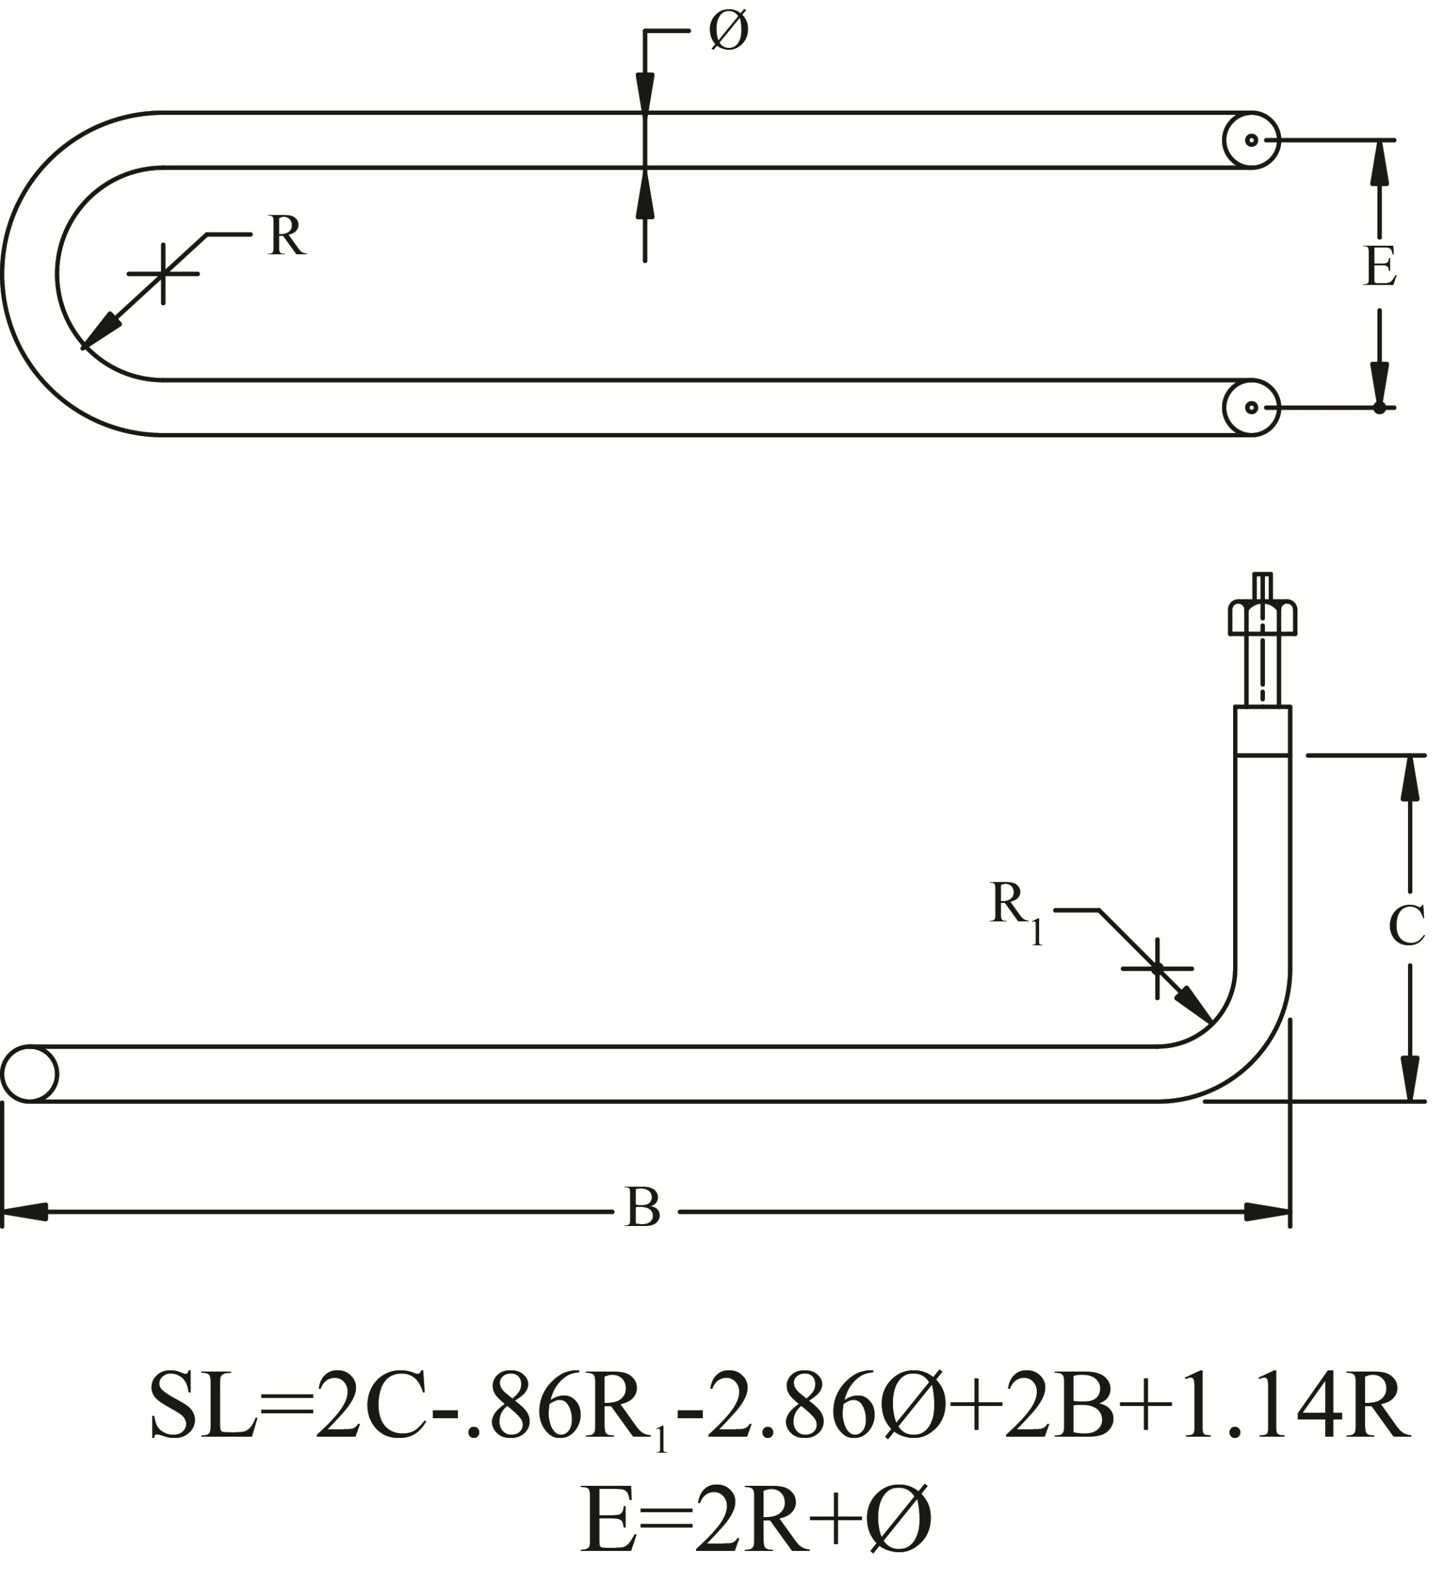
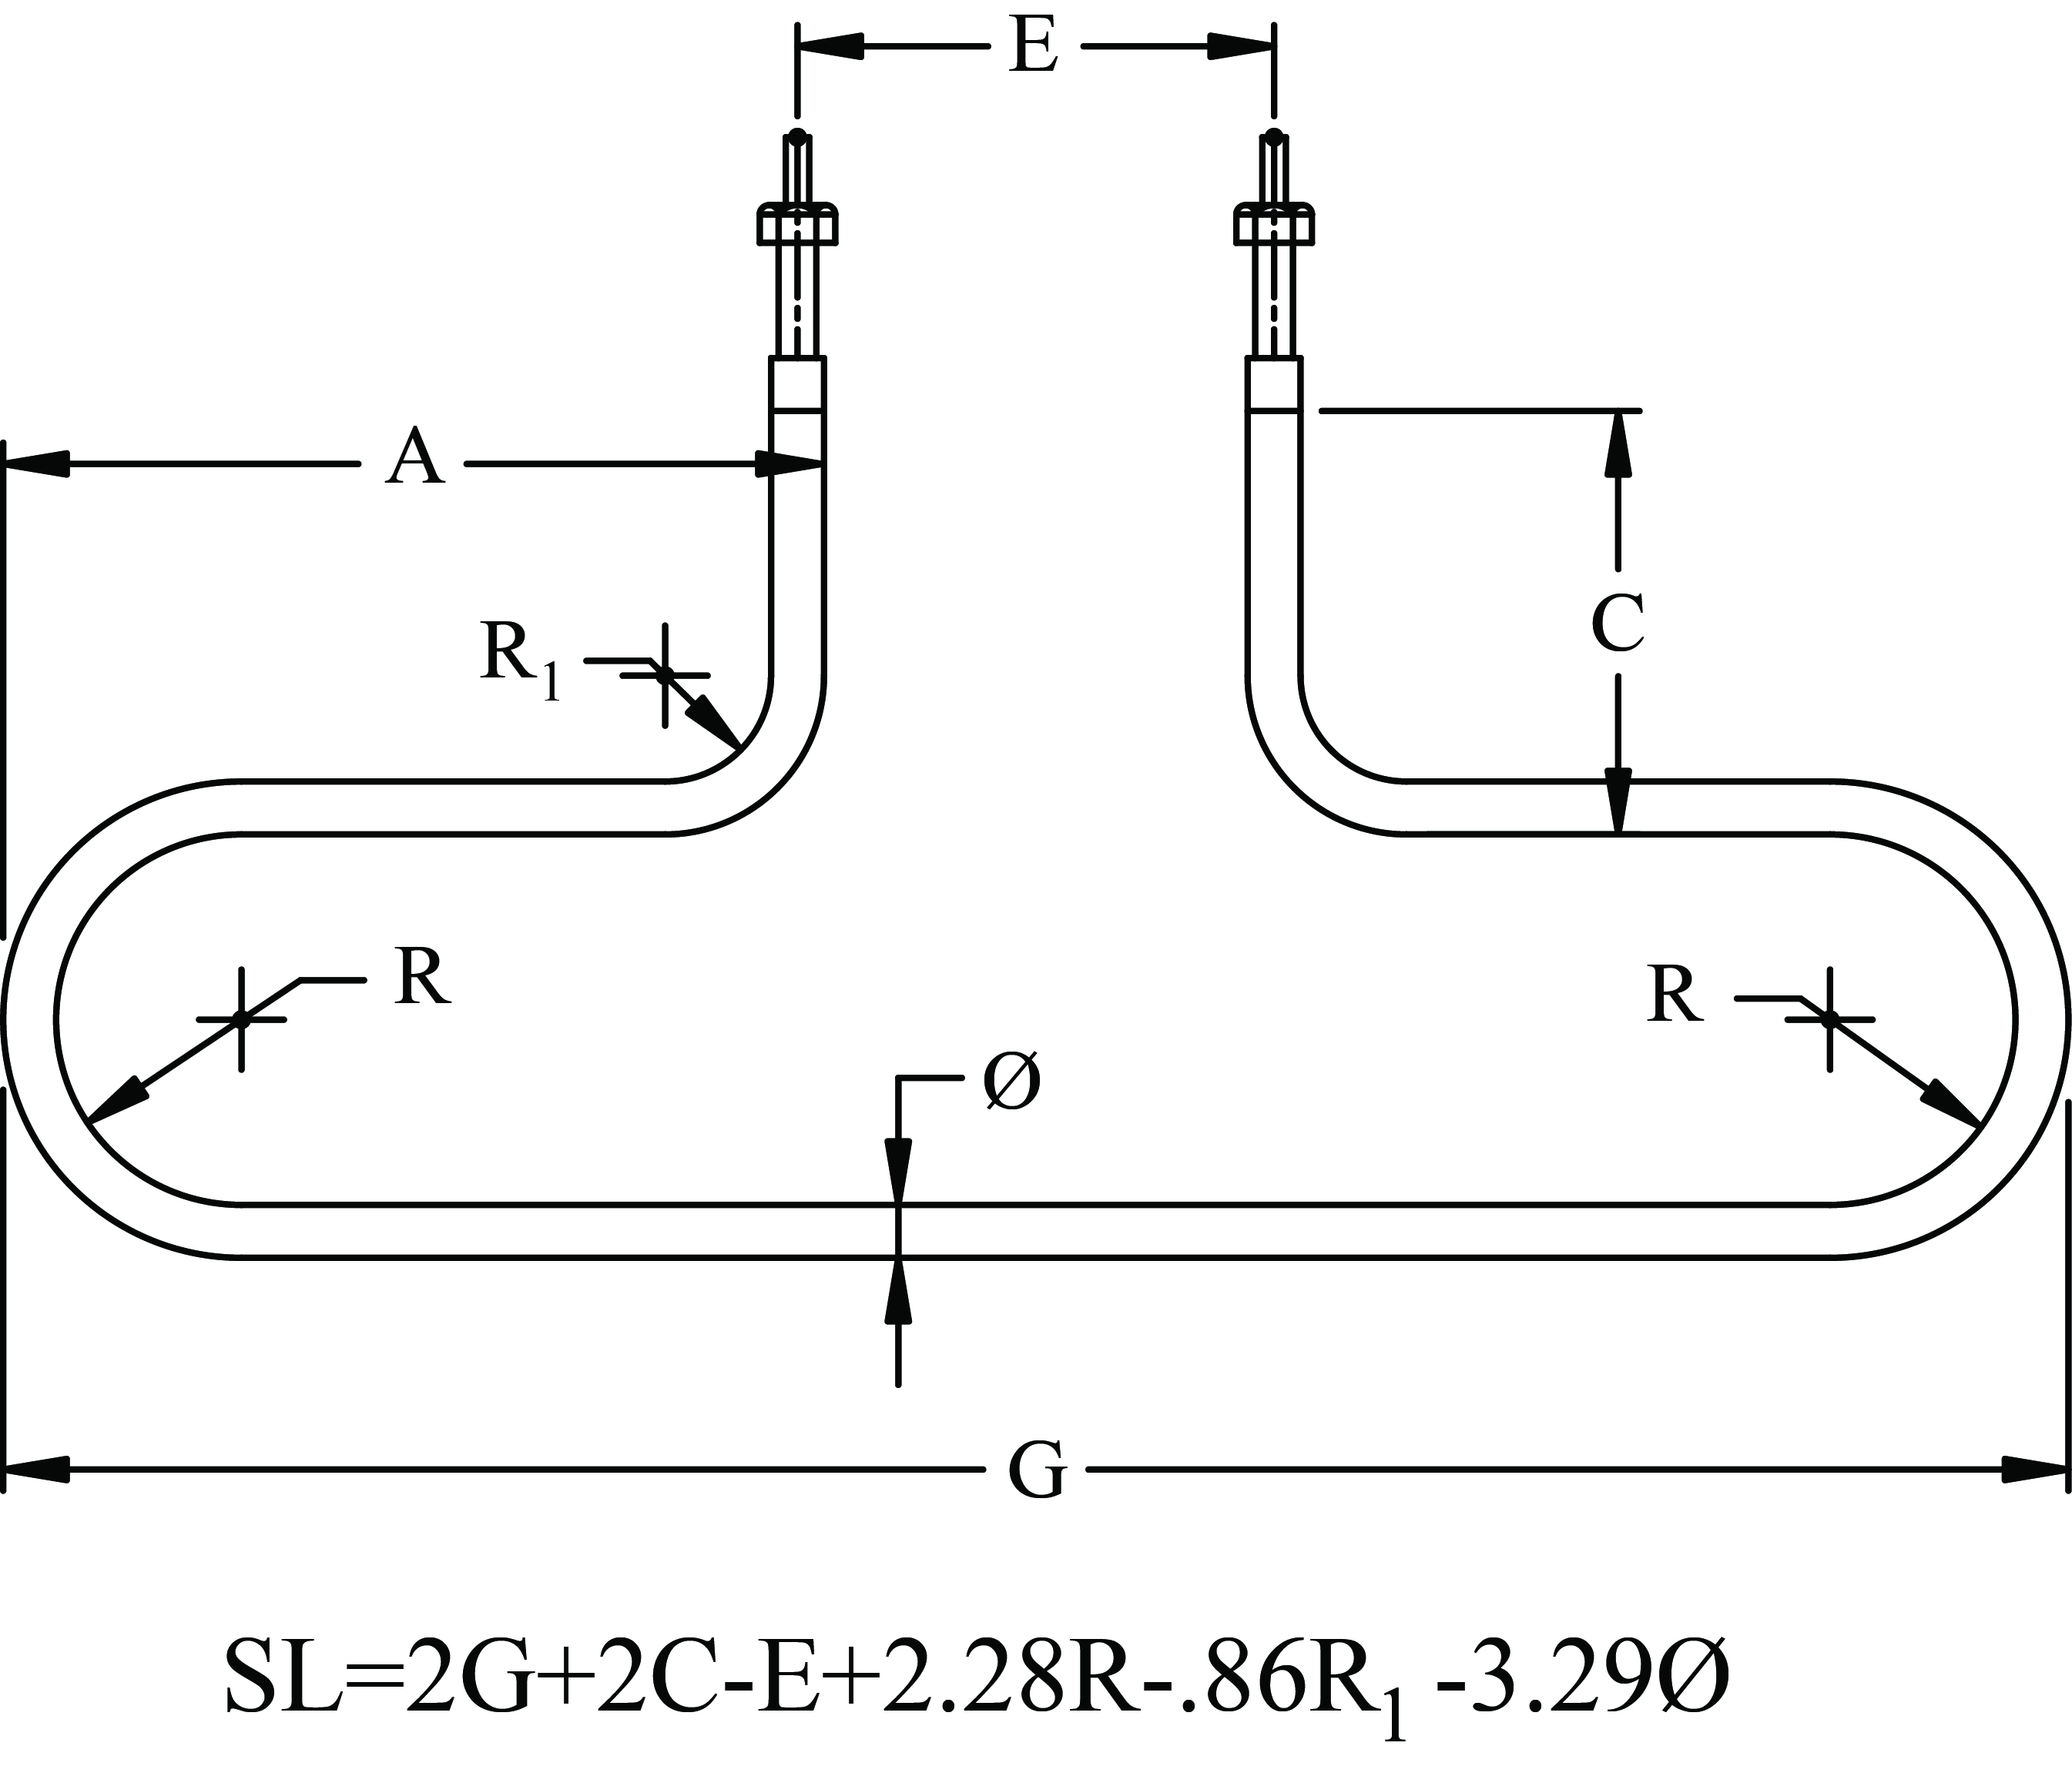
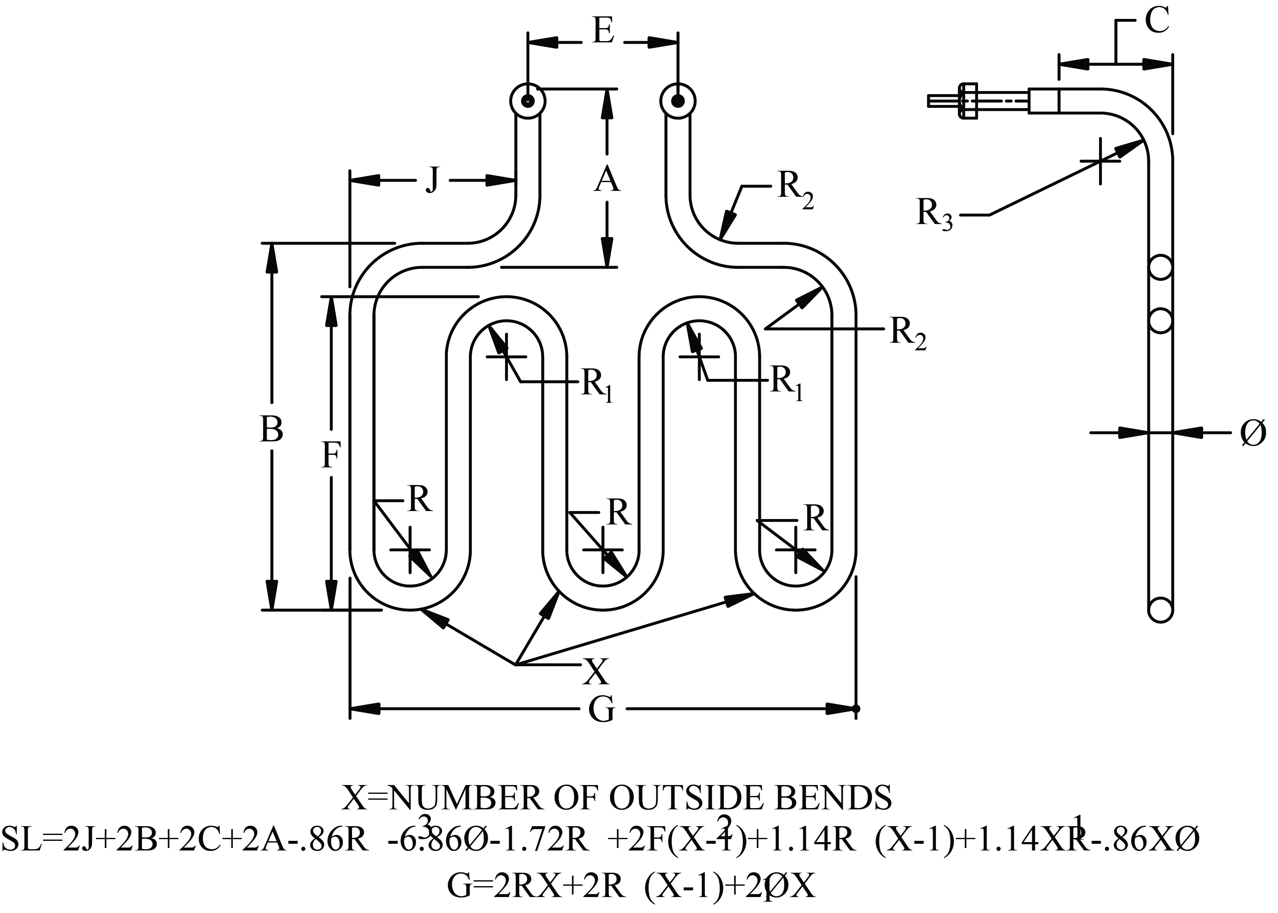
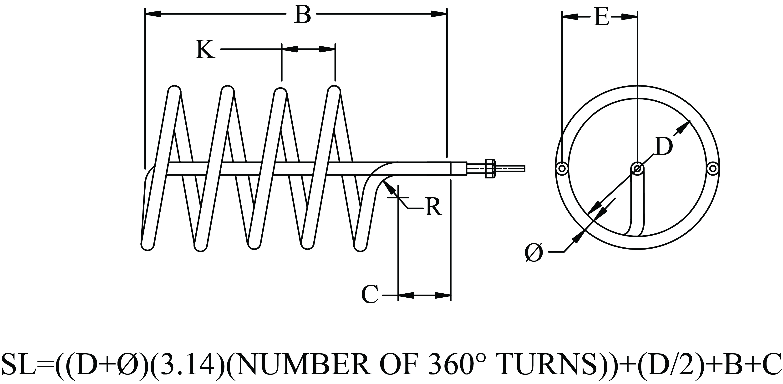
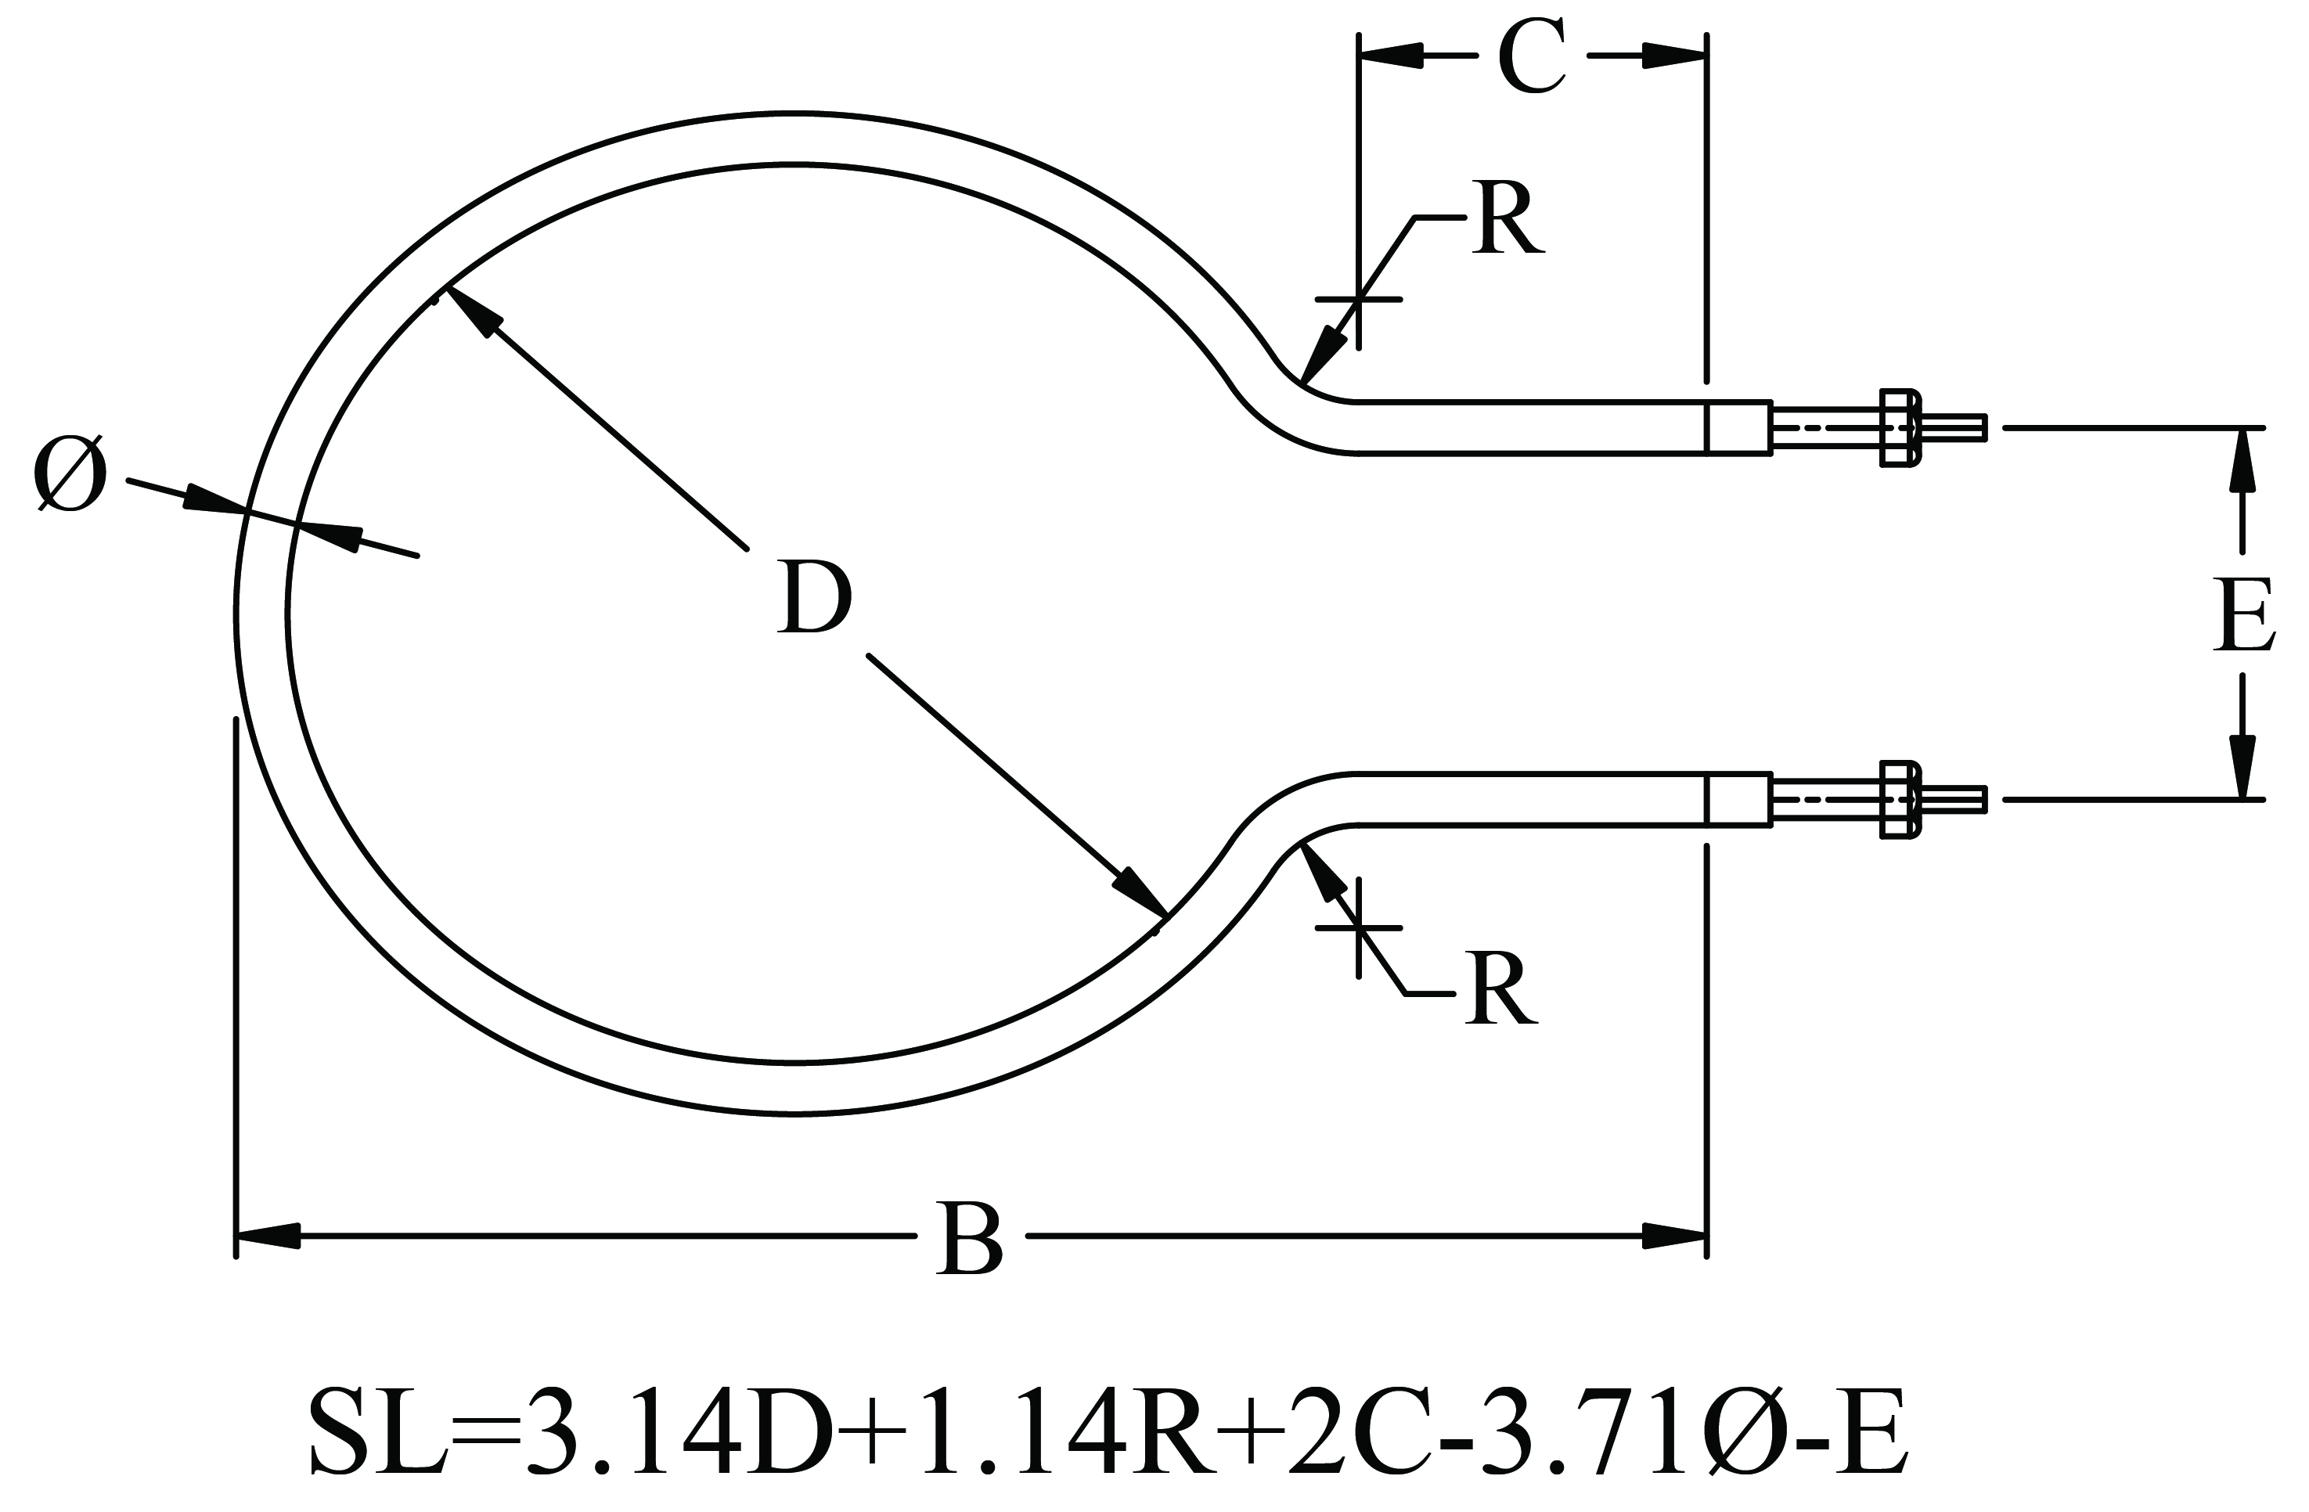
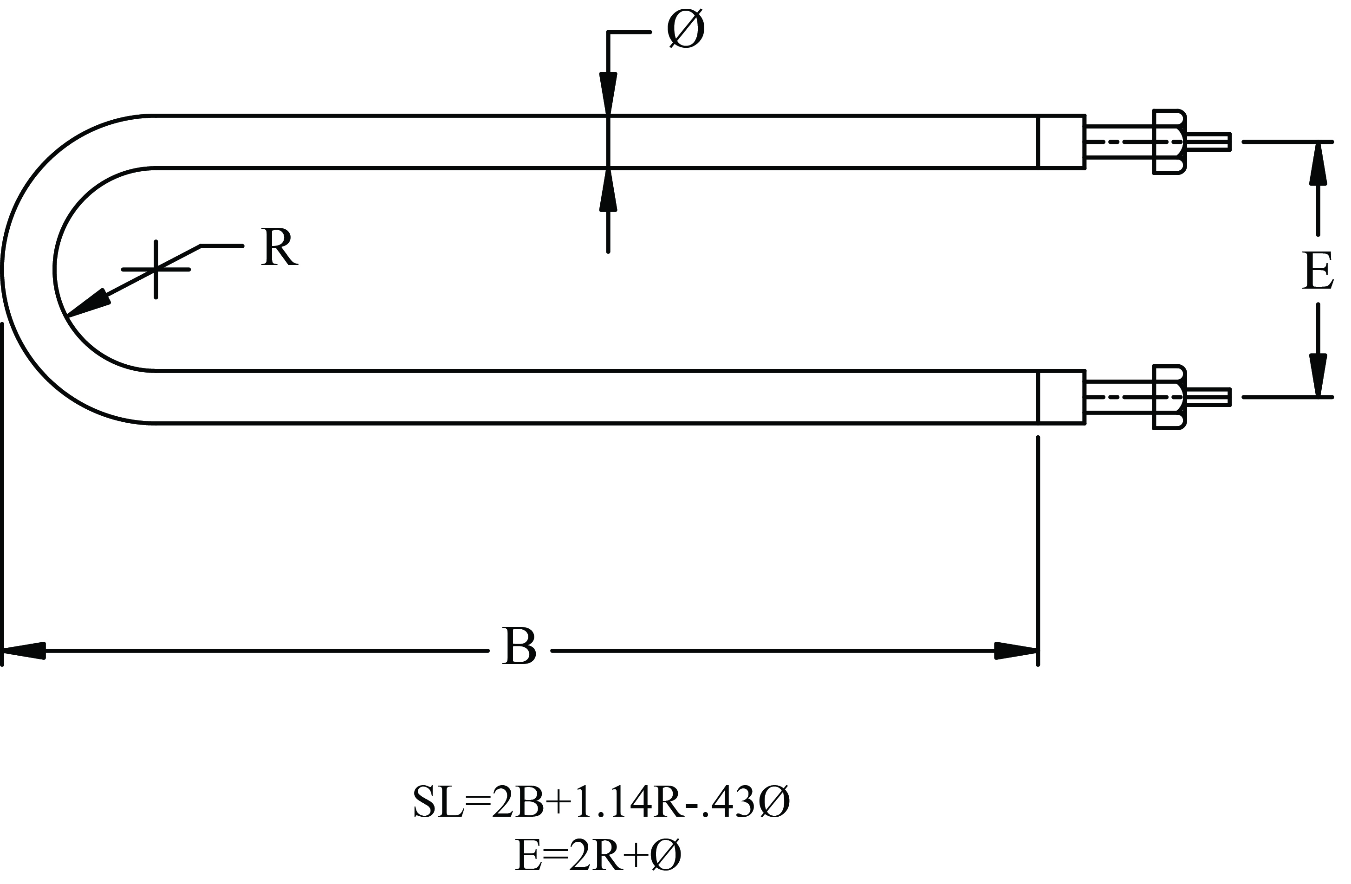
Tubular Electric Heaters
Convectronics’ Tubular Electric Heaters can be formed into a multitude of different shapes. Here are just a few of the common designs used.
convectronics.com

Slide 25
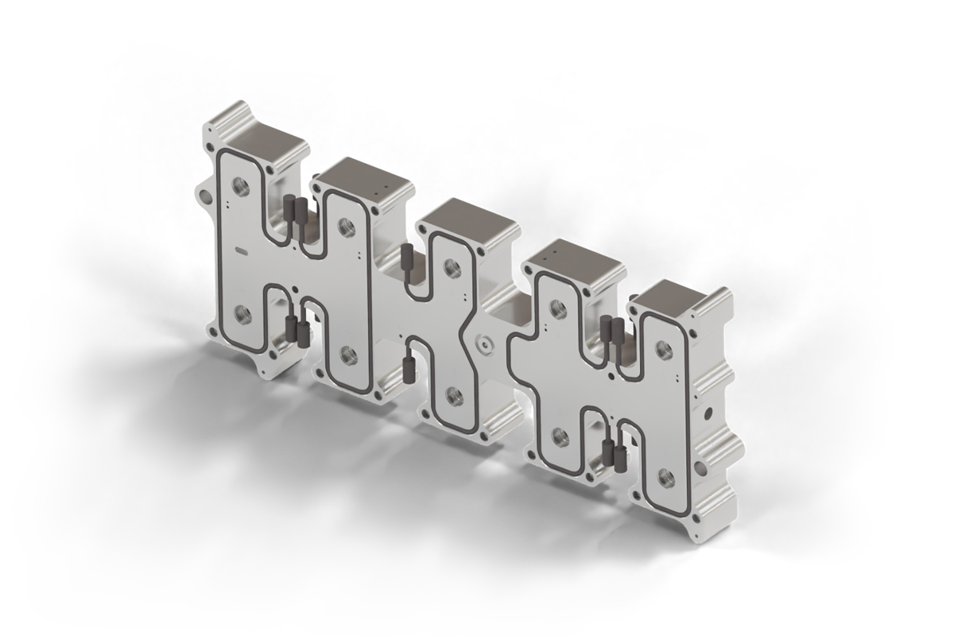




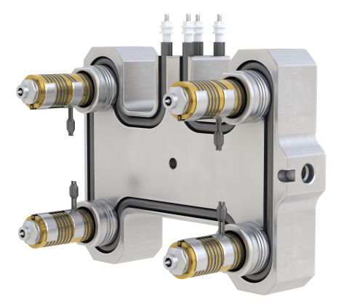
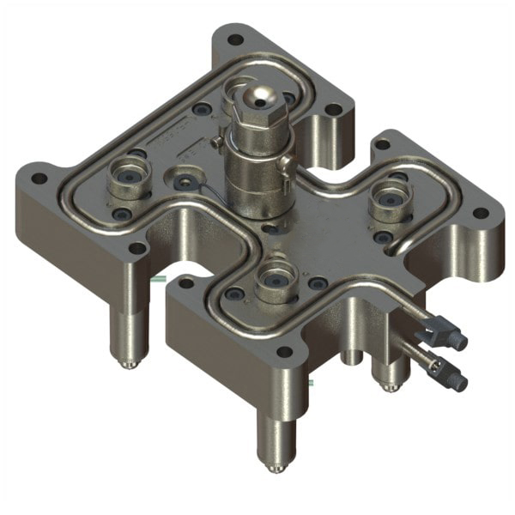
Tubular Electric Heaters
Advanced Thermal Management for
Hot Runners & Manifolds
Complex Geometry Integration: Formed into tight, custom-engineered profiles to wrap precisely around hot runner nozzles and drop configurations.
Balanced Manifold Heating: Delivers uniform heat distribution across complex flow paths to eliminate cold spots and prevent polymer degradation.
Extreme Thermal Stability: Incoloy® 800 and T321 Stainless Steel sheaths withstand the high clamping forces and structural stress of continuous injection molding cycles.
Optimized Cycle Times: Provides rapid thermal response and precise control to ensure repeatable shot-to-shot consistency and reduced scrap rates.
convectronics.com

Slide 26
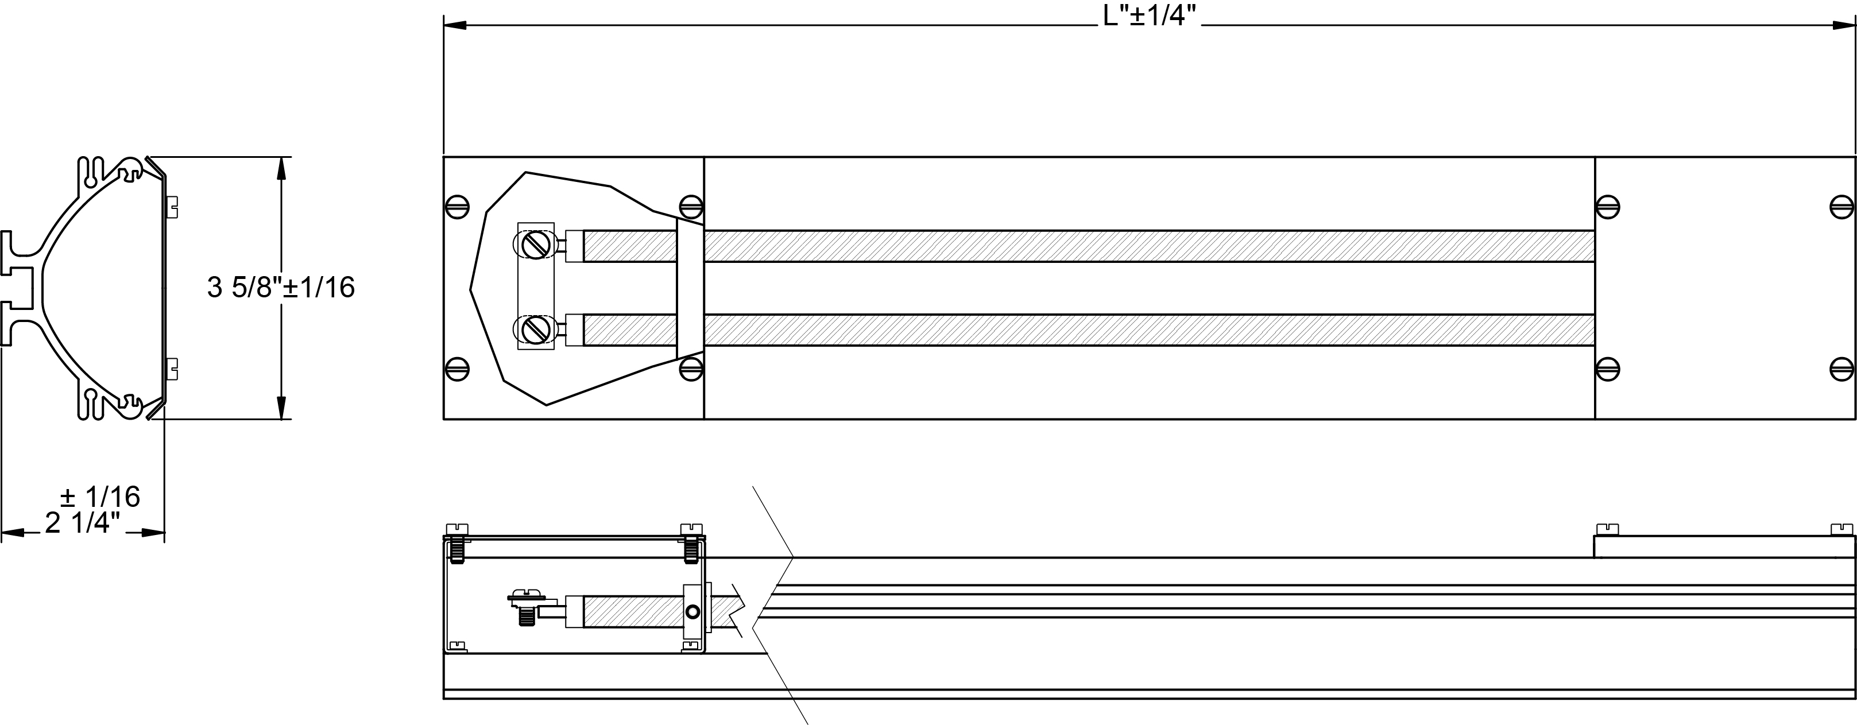
Radiant Process Heaters
Convectronics’ Series RH Radiant Heater Assemblies are tubular heaters mounted in an aluminum housing with a polished reflector. Both metal and quartz heaters can be used. This package delivers infrared heat (2.5 – 3 micron range) to the surface being heated over a typical range of 500°F. The practical maximum temperature is 900°F.
STANDARD RANGES
Voltage: 120, 240 and 480
Wattage: 800 to 7200
Length: 24 to 86 inches
Custom Designs welcome!
CONSTRUCTION
Rigid extruded aluminum housing
Incoloy® 800 sheathed tubular element
Polished aluminum reflector
Adjustable mounting bolts (3/8” Dia)
½” NPT tapped wiring holes
Snap-on protective grill available
APPLICATIONS
Ideal for applications where high velocity air is not practical, such as:
Resin Curing
Plastics Processing
Food Processing
Ink Drying
Paper Products manufacture
Ceramic Drying
Fabric manufacture
convectronics.com

Slide 27
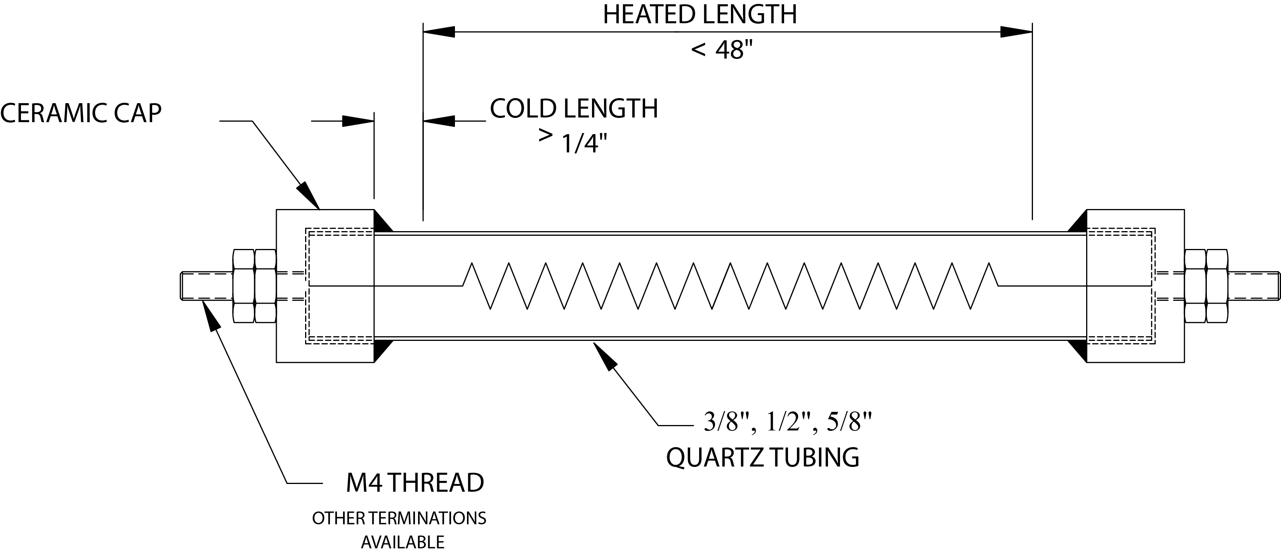


Quartz Radiant Infrared Heaters
Convectronics’ Quartz Radiant Infrared Heaters produce short-to medium-wave infrared radiation that directly heats objects rather than heating air. Quartz is transparent to IR and allows very fast response, high power density and focused directional heating making these heaters efficient for rapid, targeted heating tasks.
FEATURES
Translucent quartz tube for fast response
Three diameters available: 3/8”, ½” & 5/8”
Heated lengths to 48”
Designed for horizontal use
Two mounting methods available
Custom designed
APPLICATIONS
Industrial drying, curing and paint drying (coatings, powder coating, shrink-wrapping)
Food Processing and warming
Fast industrial heating, heat-treating and thawing of materials
Incubators
convectronics.com

Slide 28
Temperature Sensors
Spanning the Total Temperature Spectrum
Range: -450°F to +4200°F (Oxidizing, Reducing, Neutral Atmosphere
Noble/Refractory Metal Sheaths
Noble/Refractory Metal Elements
RTD Assemblies
Base Metal TC Assemblies
CONVECTRONICS, Inc. provides comprehensive temperature sensing
and control solutions, manufacturing custom and standard design
Thermocouples and RTD’s - including noble and refractory metal
options - with Just‑In‑Time delivery.
Our products combine high quality, reliable performance, and
competitive pricing to meet the most demanding temperature-
measurement requirements.
convectronics.com

Slide 29
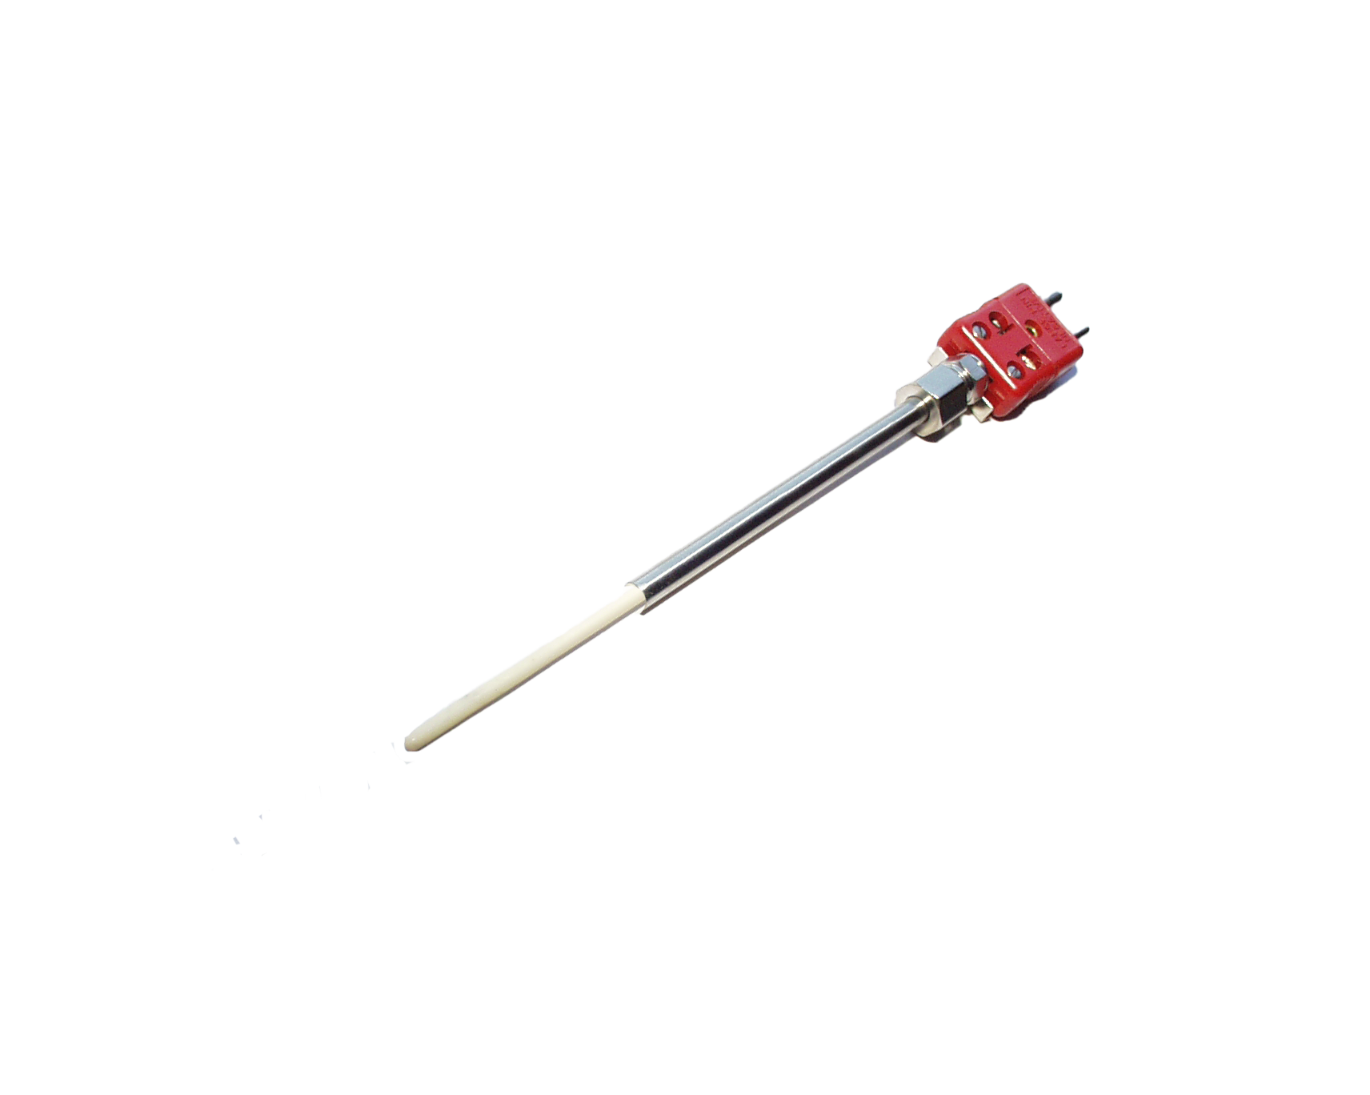
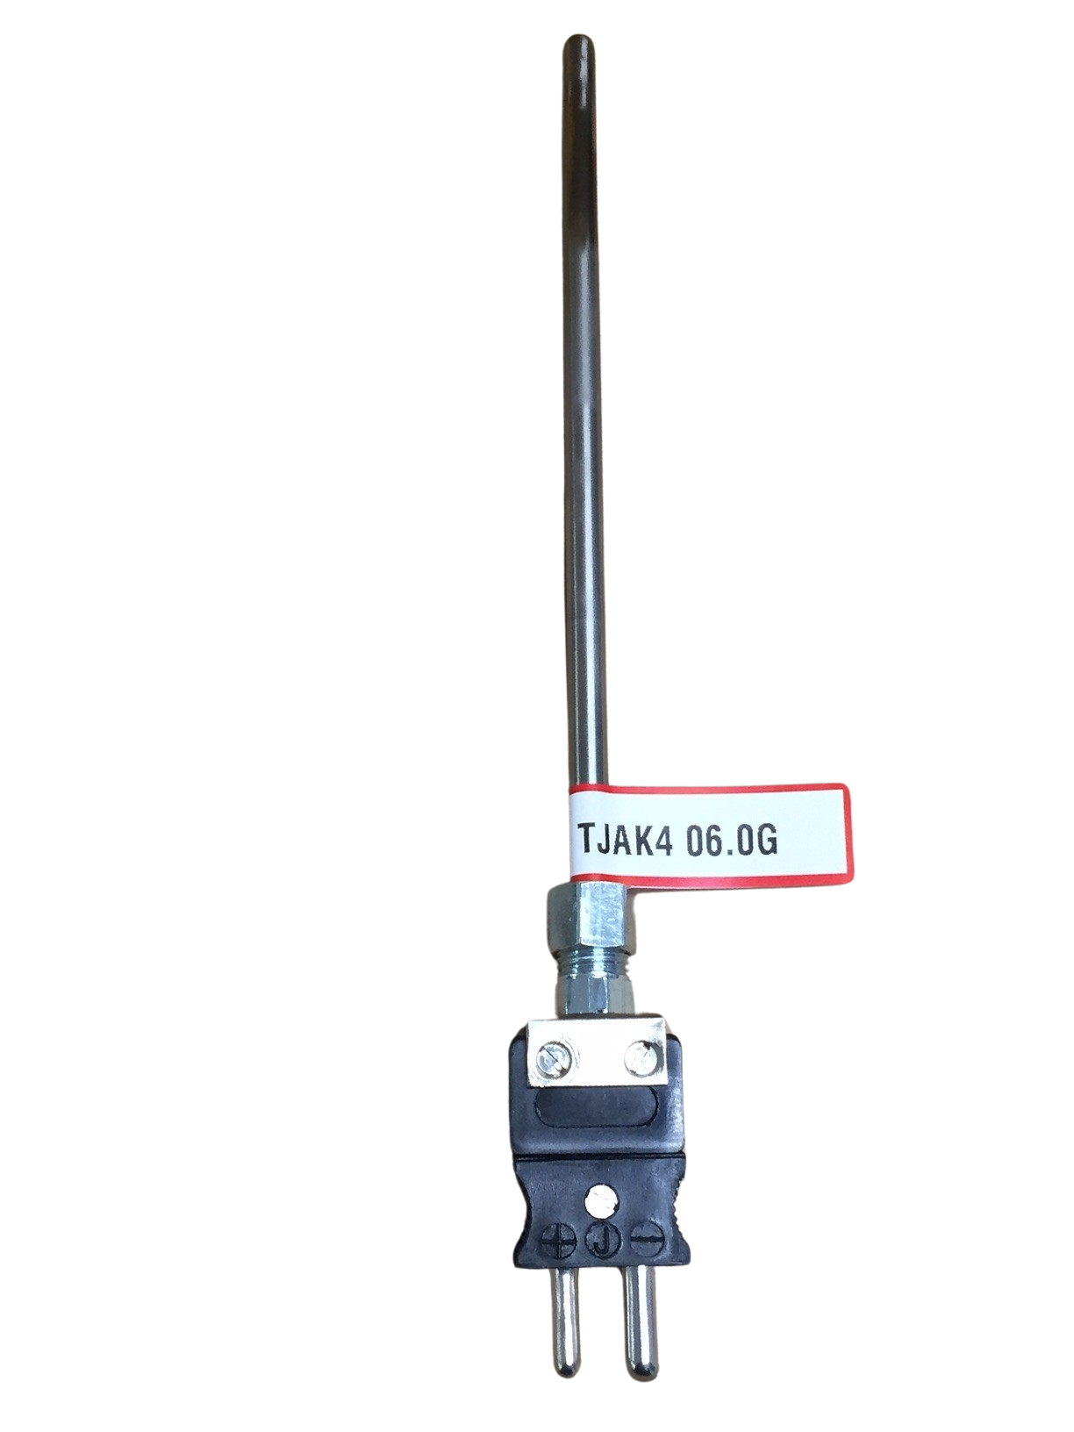













Temperature Sensor Selection
Thermocouple & RTD Designs:
Bare & Insulated Wire
Beaded Ceramic/Wire
Tube & Wire
Fixed Bayonet
Adjustable Bayonet
(Tube, SSOB & Armor)
Nozzle Style
Bolt Style
Mineral Insulated w/ connectors
Mineral Insulated w/ transitions
and wire
Industrial Head/Block Type
Paddle Type
Lug and Washer Styles
Bare Ribbon
Refractory Metal/Ceramic
Noble Metals
Base Metals
Just to name a few…
convectronics.com

Slide 30


Temperature Sensor Selection
High Temperature Thermocouple Probes
Noble and refractory metals, advanced ceramics, and specialty materials for sheaths, wires, and insulation — engineered to top manufacturing standards for peak performance and extended service life.
Thermocouple Elements
Refractory Oxide Insulators
Calibration | Max. Oper. Temp. | Max. Expos. Temp. | Recommended Environment
Pt-10% Rh/Pt ANSI Type S | 2700°F 1482°C | 3100°F 1704°C | Oxidizing, Inert
Pt-13% Rh/Pt ANSI Type R | 2700°F 1482°C | 1300°F 1704°C | Oxidizing, Inert
Pt-30% Rh/Pt-6%Rh ANSI Type B | 3100°F 1704°C | 3220°F 1770°C | Oxidizing, Inert
W/W-26% Re W-5% Re/W-26%Re W-3% Re/W-25%Re | 5000°F 2760°C | 5430°F 3000°C | Vacuum, High Purity, Hydrogen & Inert.
Pt-Platinum, Rh-Rhodium, W-Tungsten, Re-Rhenium
Material | Approx. Melt. Temp. | Max. Rec. Temp.
 |  | Hard- Fired | Swaged
Magnesia Mg0 | 5070°F 2800°C | N/A | 3400°F 1870°C
Alumina AL2O3 | 3650°F 2010°C | 3200°F 1760°C | 3000°F 1650°C
Beryllia* Be0 | 4620°F 2550°C | 4200°F 2315°C | N/A
Hafnia HfO2 | 5252°F 2900°C | 4352°F 2400°C | N/A
* Caution: Beryllia Dusts are toxic
convectronics.com

Slide 31
Temperature Sensor Selection
Sheath Material Specs | Melting Point (approx.) | Corrosion Resistance | Thermal Cycling | Atmospheres |  | Thermal Shock | Other
Tantalum (Ta) | 5430°F | Most corrosion resistant | Excellent | Good in reducing or neutral at elevated temps | Poor in oxidizing atmospheres | Good to excellent thermal shock resistance | Corrosion resistant up to 3000°F
Molybdenum (Mo) | 4750°F | Highly corrosion resistant in many environments | Excellent | Excellent in reducing or neutral | Poor in oxidizing atmospheres | Excellent thermal shock resistance | Excellent mechanical properties at elevated temps
Alumina (AL₂O₃) | 3686°F | Excellent resistance | Poor | Oxidizing, reducing & high vacuum applications | Not for use in high vacuum w/ graphite above 2372°F | Good thermal shock resistance | High thermal conductivity
Zirconia (ZRO₂) | 4919°F | Resists most chemical reactions | Poor | Inert, oxidizing and Reducing | Stable in O₂ rich atmospheres w/out degradation | Excellent thermal shock resistance | Useable to 4400°F with 0% water absorption
Fused Quartz 99.9% SIO₂ | 3038°F | Unreactive w/ most acids, metals, chlorine & bromine. | Good | Oxidizing, inert & neutral | Devitrifies rapidly at temps above 1800°F | High thermal shock resistance | Slightly attacked by alkaline solutions
convectronics.com

Slide 32


Temperature Sensor Selection
Applications
High temp furnaces (ceramics, glass,
heat-treatment, sintering, vacuum)
Reducing atmospheres
Metallurgy and foundries (melting,
annealing, alloy processing)
Semiconductor and semiconductor-plant processes (CVD, diffusion,
wafer processing)
Electron-beam and physical vapor deposition (PVD) systems
Thermal processing in molten salts or metal baths
Chemical and petrochemical reactors w/ corrosive gases (oxidizing/halogen environments)
Laboratory calibration and reference standards (metrology labs)
Aerospace and turbine testing
Crucible and kiln monitoring
Vacuum and controlled-atmosphere processes
convectronics.com

Slide 33


Temperature Applications
Packaging Equipment
Convectronics’ custom-formed Mineral Insulated (MI) thermocouples monitor glue reservoirs directly within packaging equipment. This precise thermal tracking ensures stable, consistent adhesive temperatures required for optimal bonding performance.
convectronics.com

Slide 34

Temperature Applications
Optimizing Biomass Pellet Mill Efficiency
Critical Monitoring: Convectronics RTDs track real-time roll temperatures in biomass pellet mills.
Asset Protection: Safeguards high-load machinery from overheating and thermal damage.
Quality Control: Empowers operators to stabilize the process and guarantee consistent pellet durability.
convectronics.com

Slide 35


Custom Designs
Aerospace/Military Thermal
Management & Regulation
Precision Control: Convectronics thermocouples provide real-time temperature feedback directly to flight system controllers.
Mission-Critical Reliability: Engineered to deliver stable, continuous sensing throughout demanding flight envelopes.
Extreme Environments: Specially ruggedized to withstand severe aerospace vibration and rapid ambient temperature swings.
Seamless Integration: Designed for compatibility with on-board electronics for advanced temperature regulation and flight deck indication.
convectronics.com

Slide 36


Custom Designs
Customer Spotlight – Tyson Foods
Model: Custom Open-Coil Air Heater
Customer: Tyson Foods
Tyson Foods had been using a stretched-coil heater to heat-seal plastic-wrapped products. However, the original heater design suffered from limited reliability, short lifespan, and high replacement costs.
To address these challenges, Convectronics engineered a custom open-coil heater specifically tailored for Tyson’s packaging process. The new design provided superior durability, thermal performance, and cost efficiency over time.
Key Features & Benefits:
Enhanced reliability under continuous production conditions
Extended operational lifespan through robust coil and mounting design
Improved heat uniformity for consistent sealing results
Reduced maintenance and downtime, lowering total cost of ownership
As a result of these performance improvements, Tyson Foods selected Convectronics as their preferred heater supplier for their packaging applications.
convectronics.com

Slide 37

Custom Designs
Customer Spotlight – Bruker Corporation
Model: Custom Through-Wire 24V–85W Heater / RTD Assembly
Customer: Bruker Corporation
Bruker is an American manufacturer of scientific instruments for molecular and materials research. For this application, Convectronics designed a custom through-wire heater and RTD assembly optimized for Bruker’s precision thermal requirements.
Key Features:
24 Volt, 85 Watt rated heater with integrated RTD sensor for precise temperature monitoring
Compact, through-wire design suitable for confined instrument housings
Custom-engineered mounting and lead configuration to integrate seamlessly with Bruker’s analytical instruments
Designed for uniform heat distribution and stable thermal feedback
convectronics.com

Slide 38


Custom Designs
Customer Spotlight — Stoppani Systems Sdn. Bhd.
Company: Stoppani Systems Sdn. Bhd. (Penang, Malaysia)
Industry: Manufacturing of precision machinery (solar, semiconductor, medical)
For their high-precision manufacturing lines, Convectronics delivered a custom stretched coil mica heater tailored to Stoppani’s quality and reliability requirements. These assemblies were designed for ease of integration into Stoppani’s systems.
Key Value Delivered:
Reliability and thermal stability to match tight process tolerances
Modular, compact assemblies that integrate well with Stoppani’s machinery
Long-term support and swap-in replacement parts for global operations
convectronics.com

Slide 39















Our Customers
convectronics.com

Slide 40

Our Neighbors
convectronics.com

Slide 41

Your Source for Process Heating Products
Why Choose Convectronics
Complete Systems: From individual heaters to integrated control solutions
Engineering Expertise: Over 40 years of design and application experience
Custom Solutions: Designed and built to exact customer specifications
Global Reach: Supporting customers in industrial, medical, and research sectors worldwide
With our technical expertise, emphasis on service, and attention to detail,
we’re sure you’ll appreciate the difference we can make in your business.
convectronics.com

